Slide 1
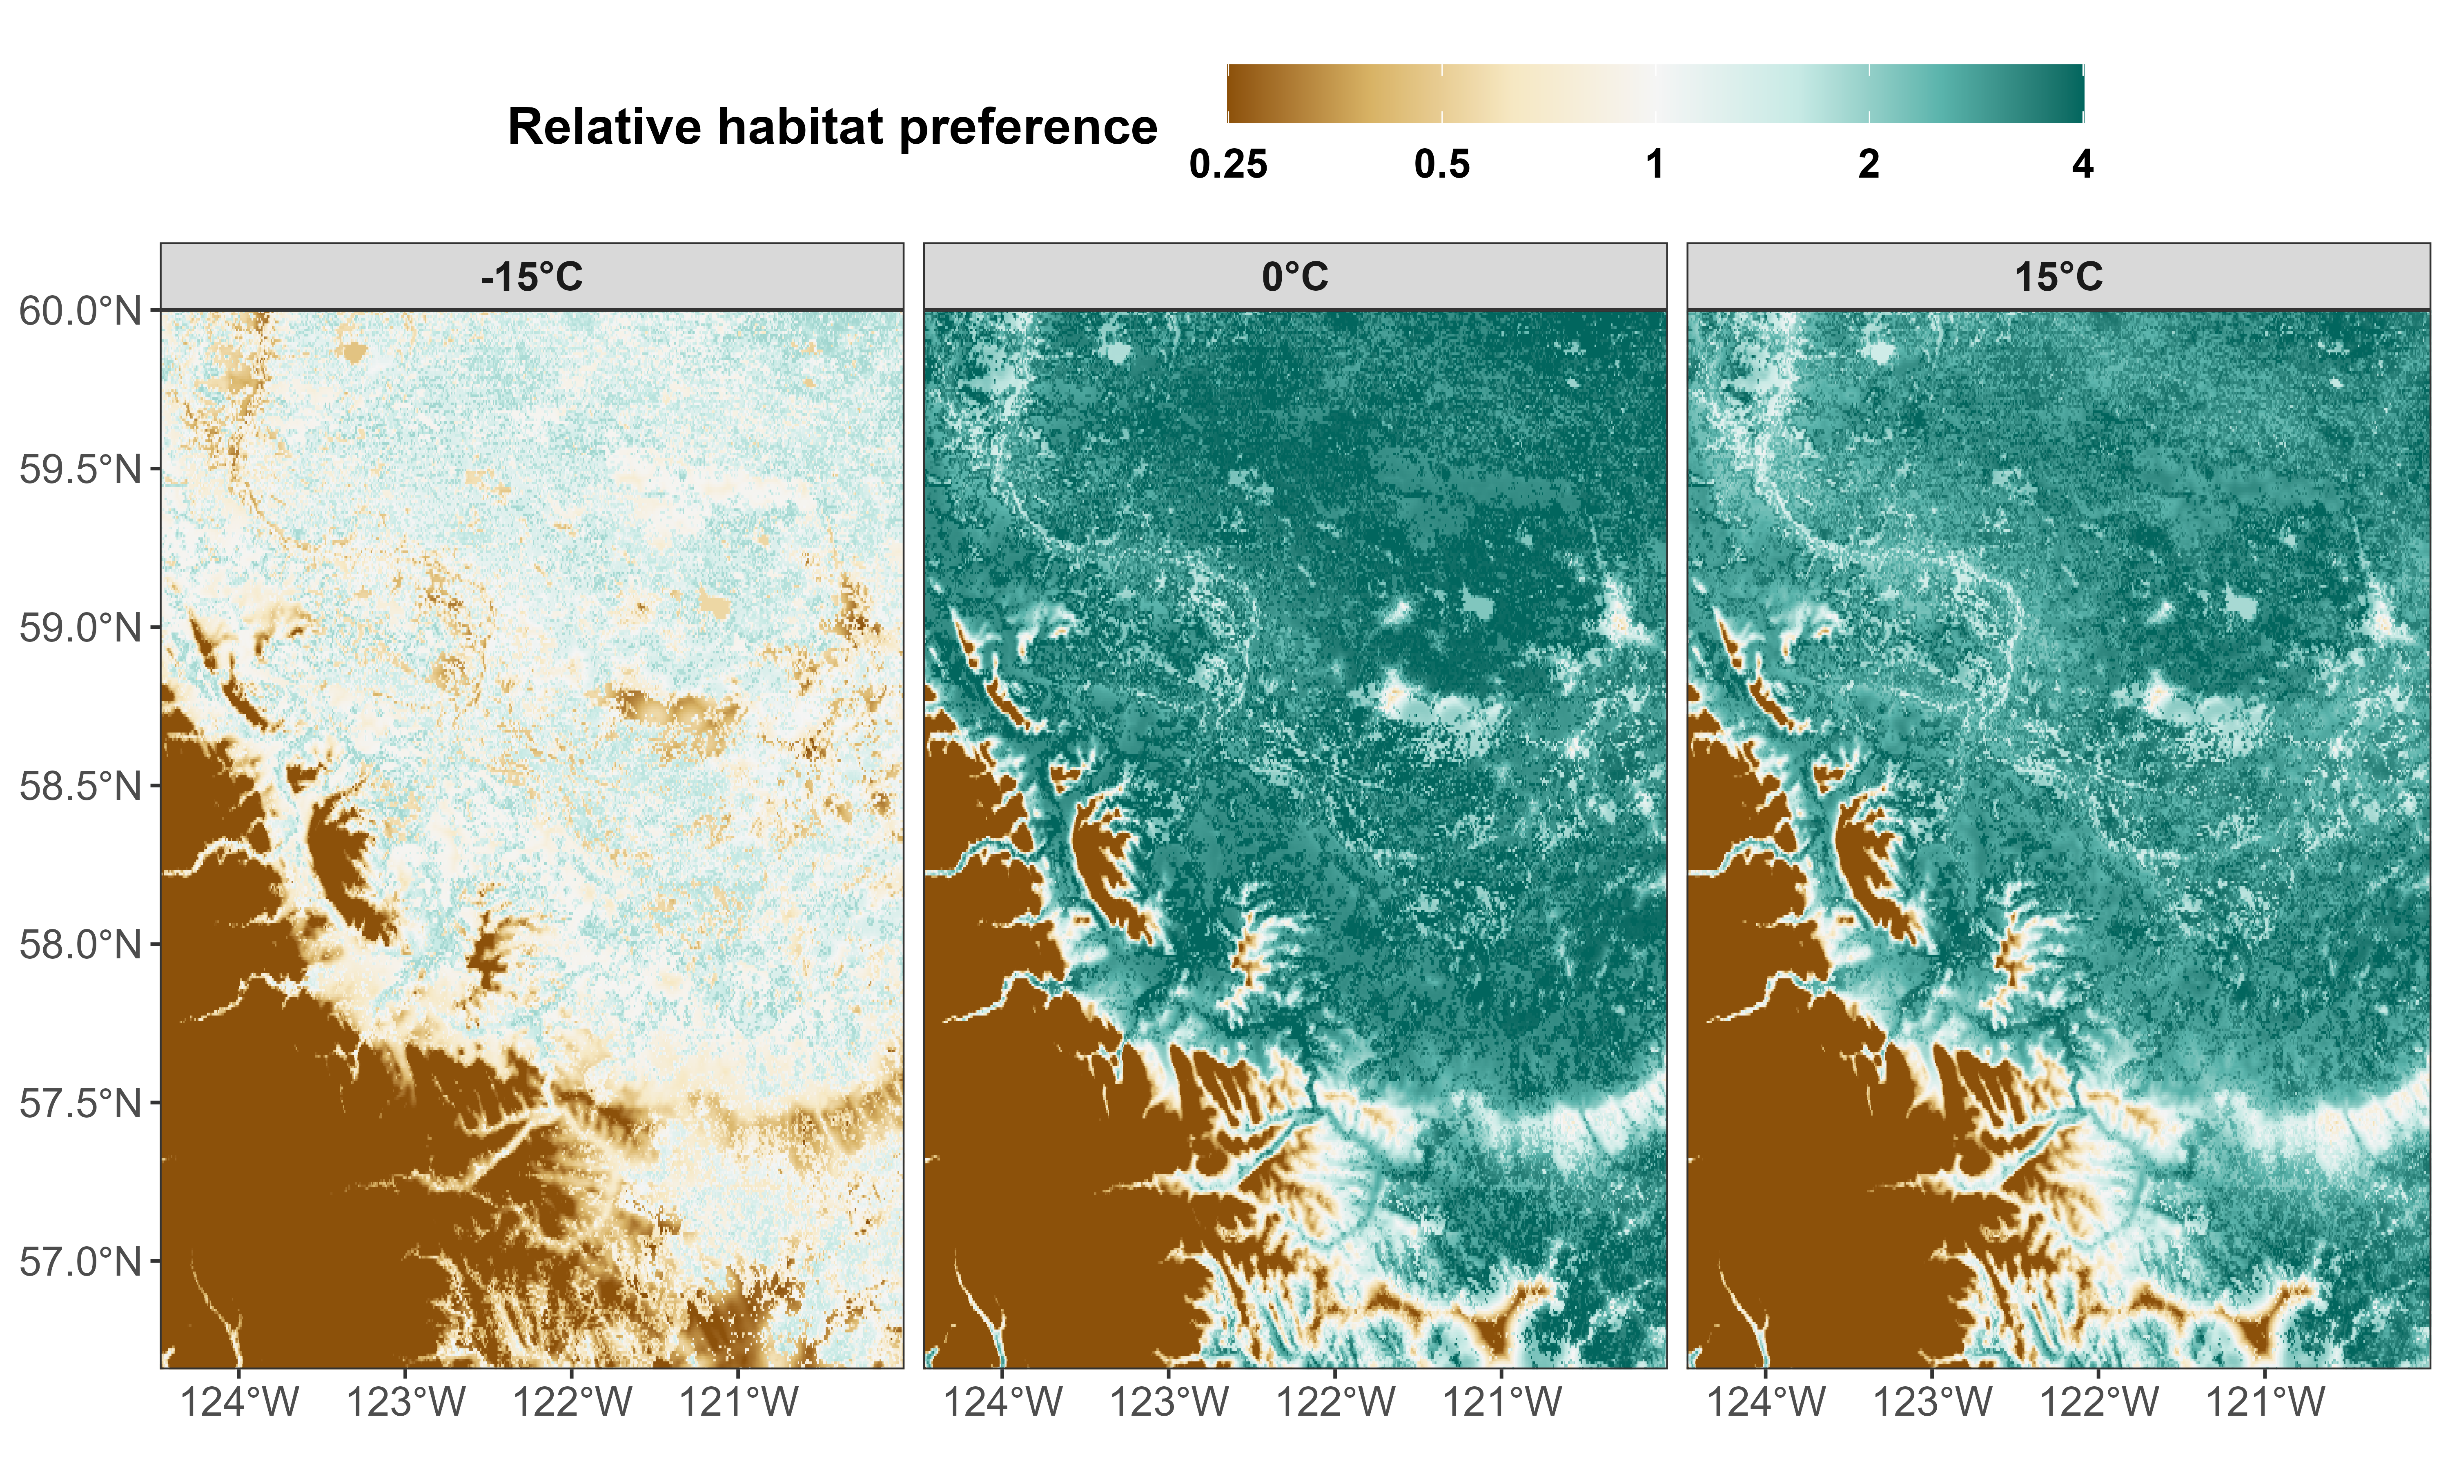
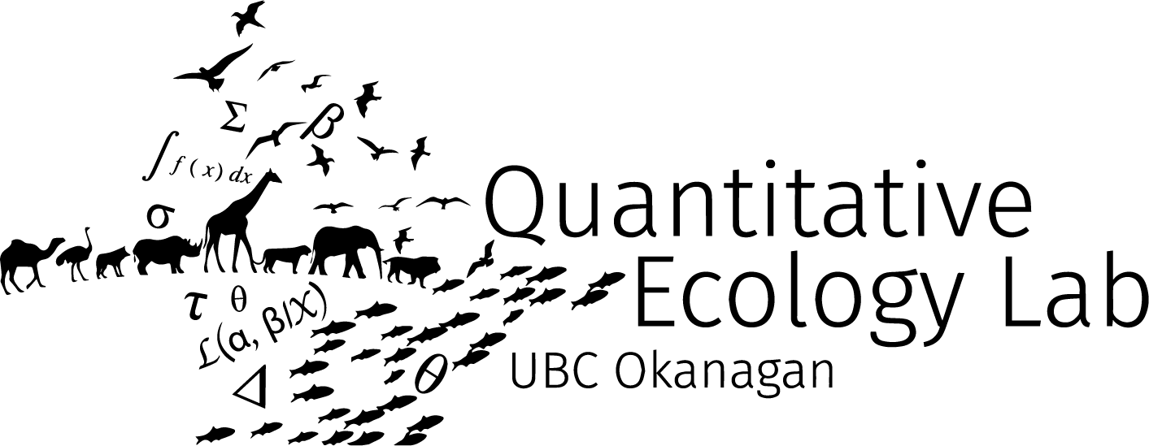

Effects of temperature on mammals’ movement and habitat selection in British Columbia, Canada
Stefano Mezzini
Ph.D. Biology candidate

Slide 2
Placing things on a map

Slide 3
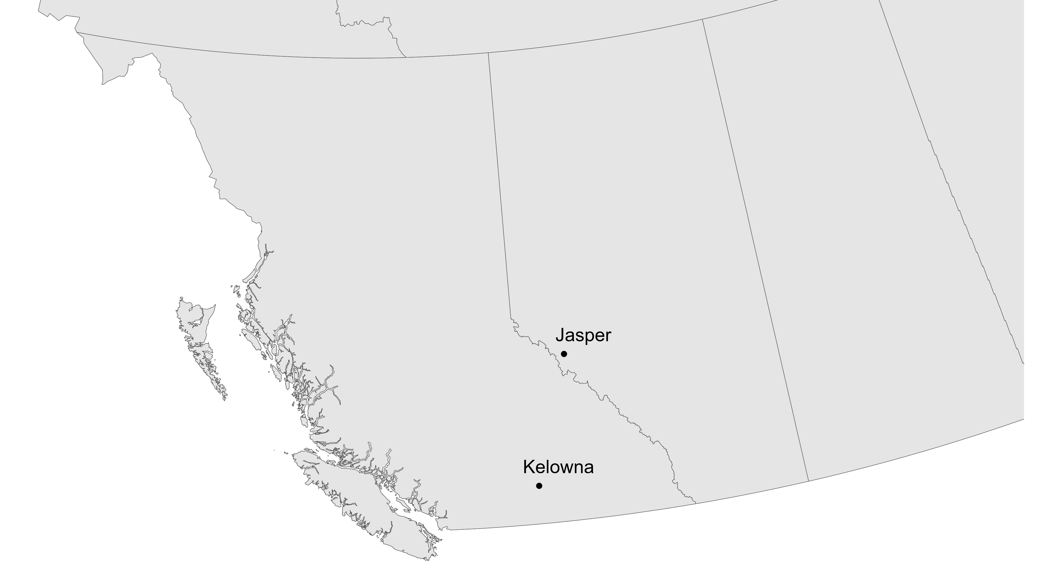

Slide 4
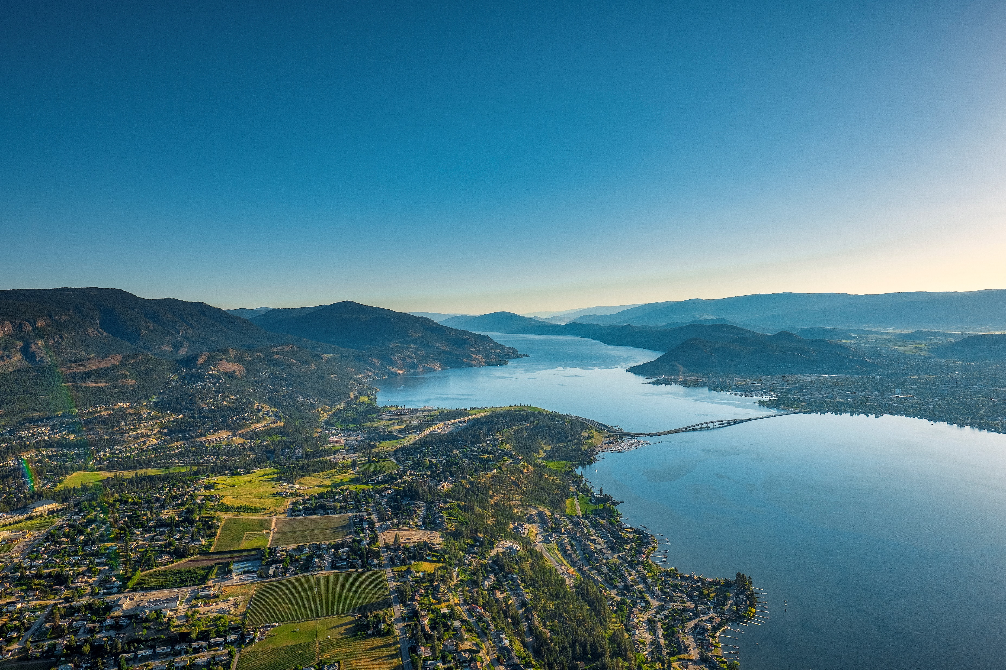
© University of British Columbia Okanagan

Slide 5
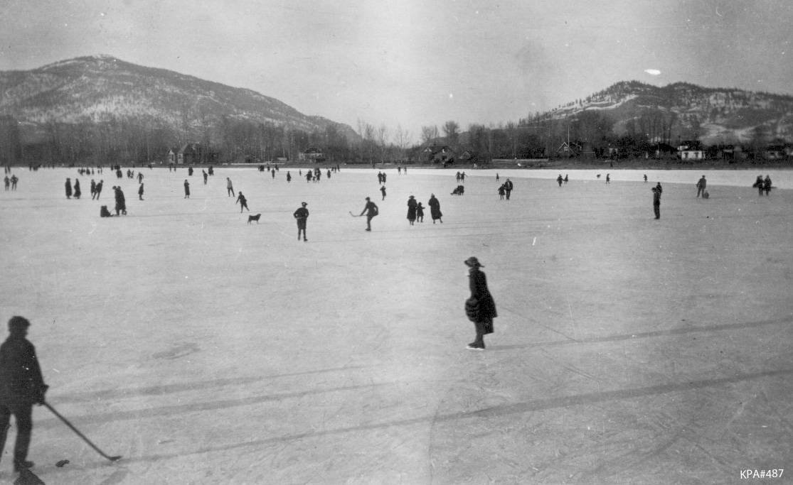
Things are not what they used to be 100 years ago
Kelowna Public Archives: KPA #487

Slide 6
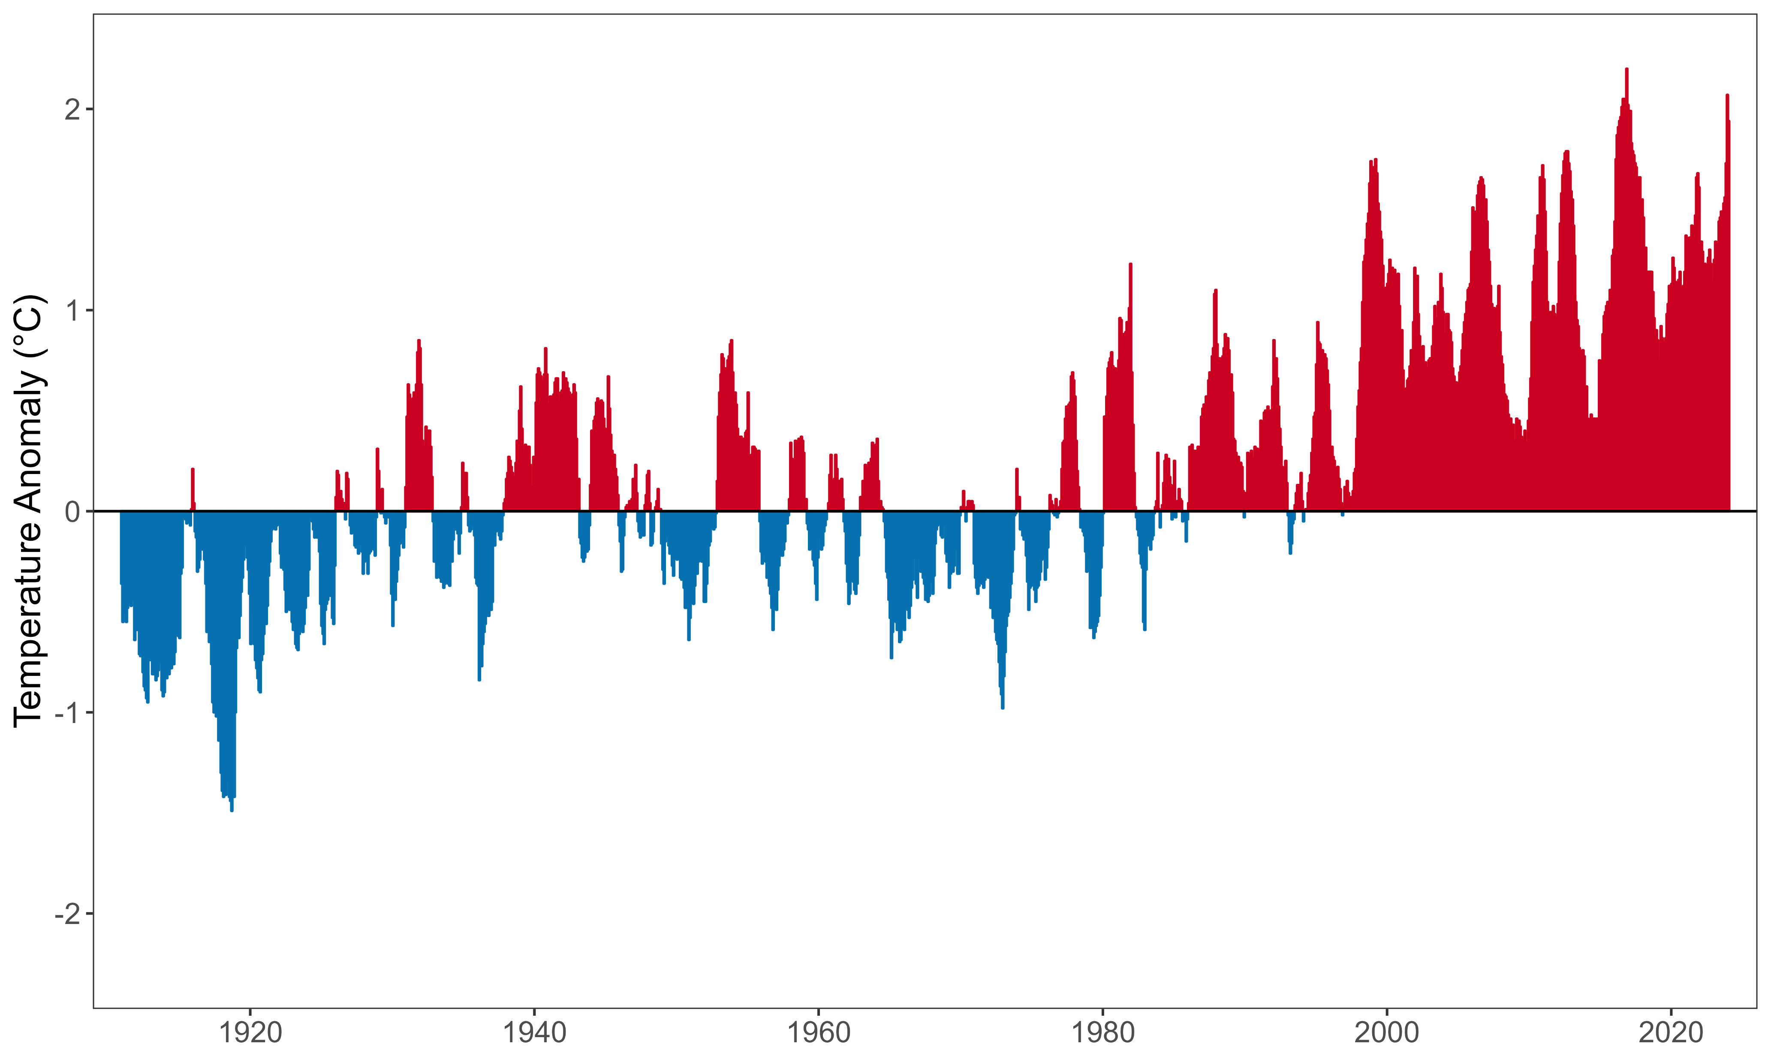
The climate is warming rapidly
(Relative to the 1910-2000 average)

Slide 7
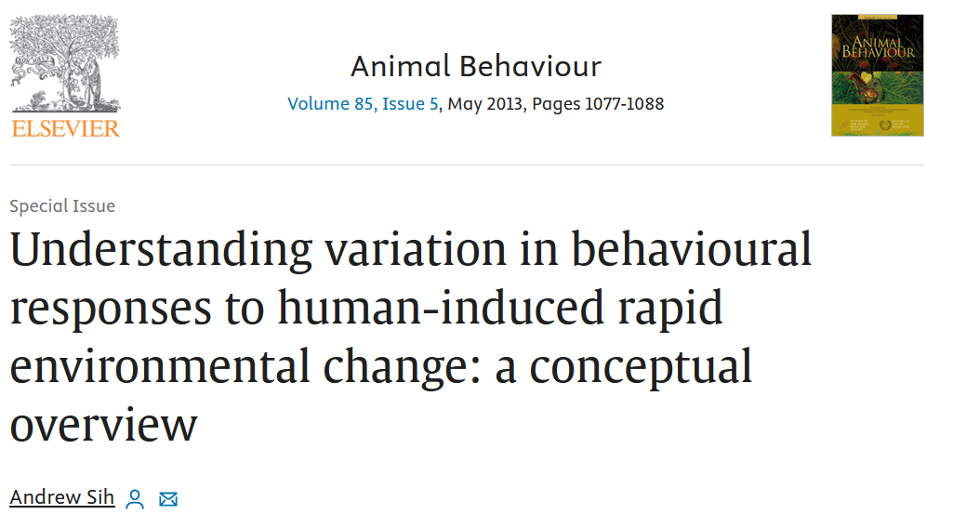
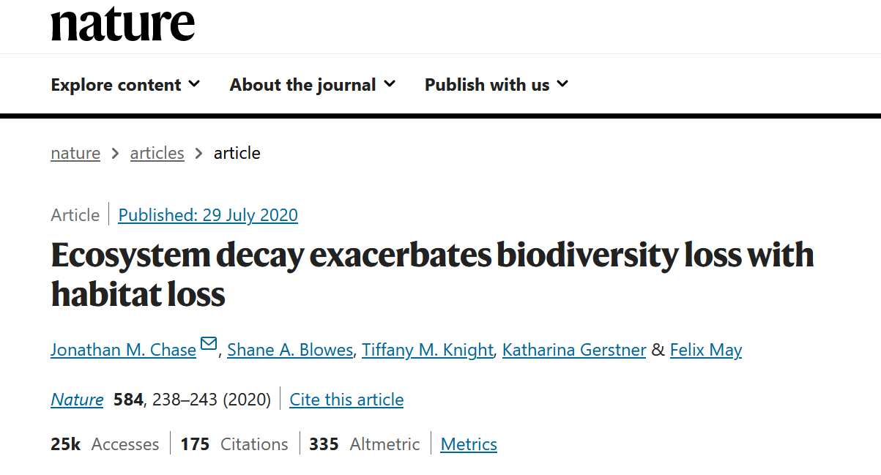
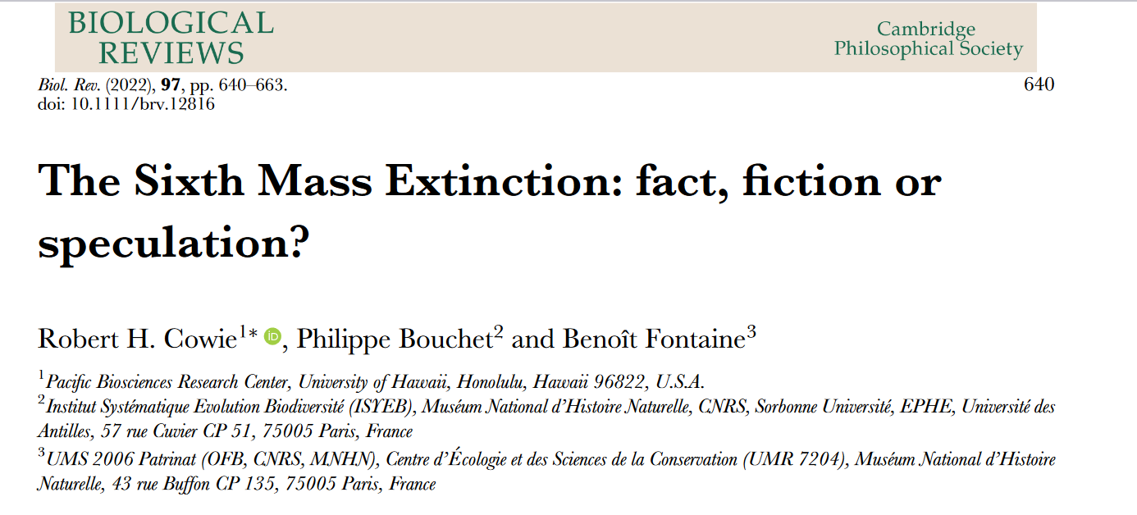
Habitats are not what they used to be 100 years ago
https://doi.org/10.1038/s41586-020-2531-2
https://doi.org/10.1016/j.anbehav.2013.02.017
https://doi.org/10.1111/brv.12816

Slide 8
What will BC look like in 100 years?

Slide 9





There are many things that affect mammal behavior

Slide 10
Temperature and movement

Slide 11
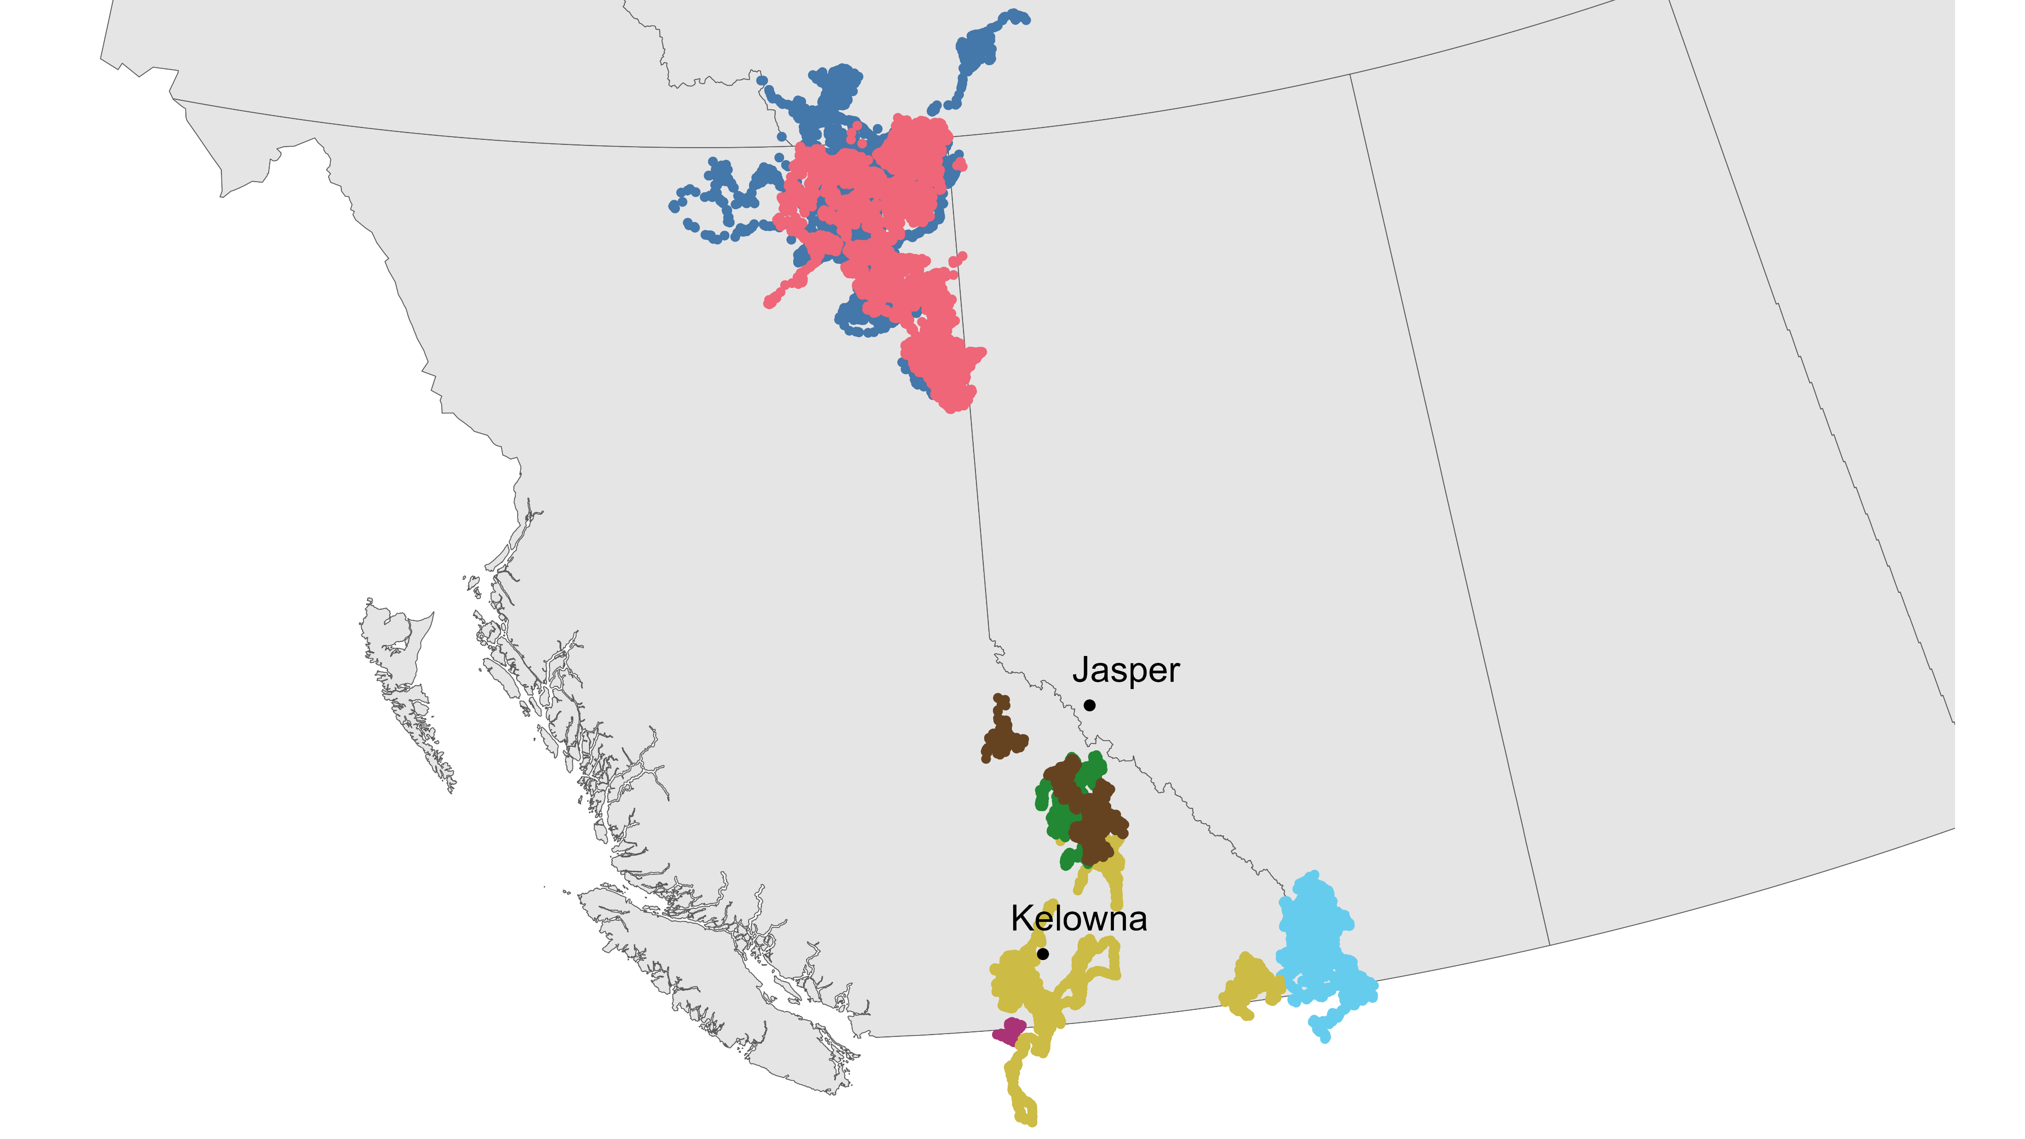



Slide 12
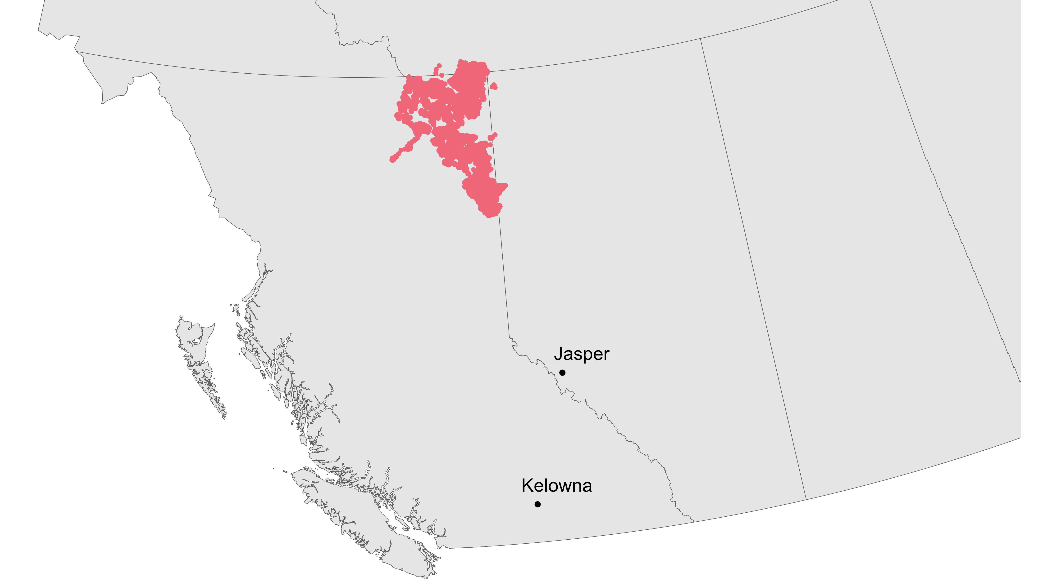

Slide 13
How does temperature affect how often boreal caribou move?

Slide 14
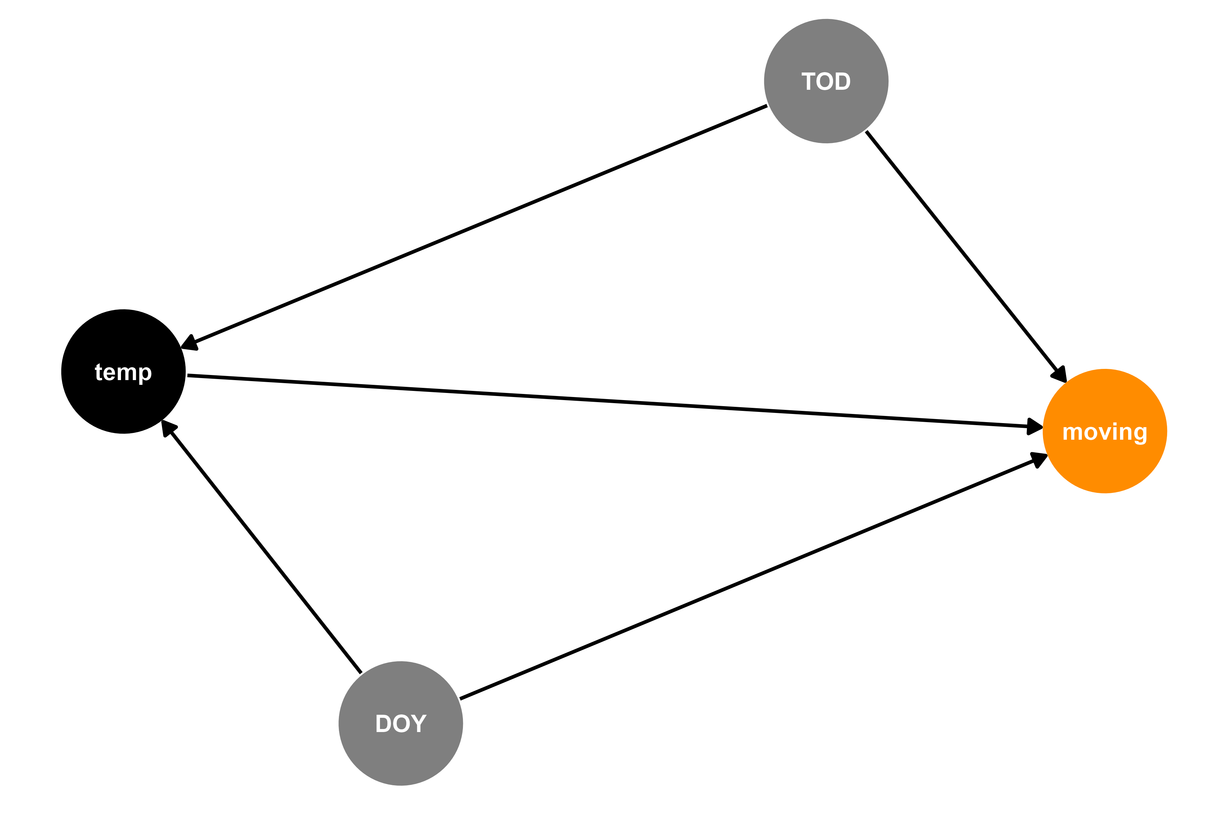


Modeling how often boreal caribou move

Slide 15
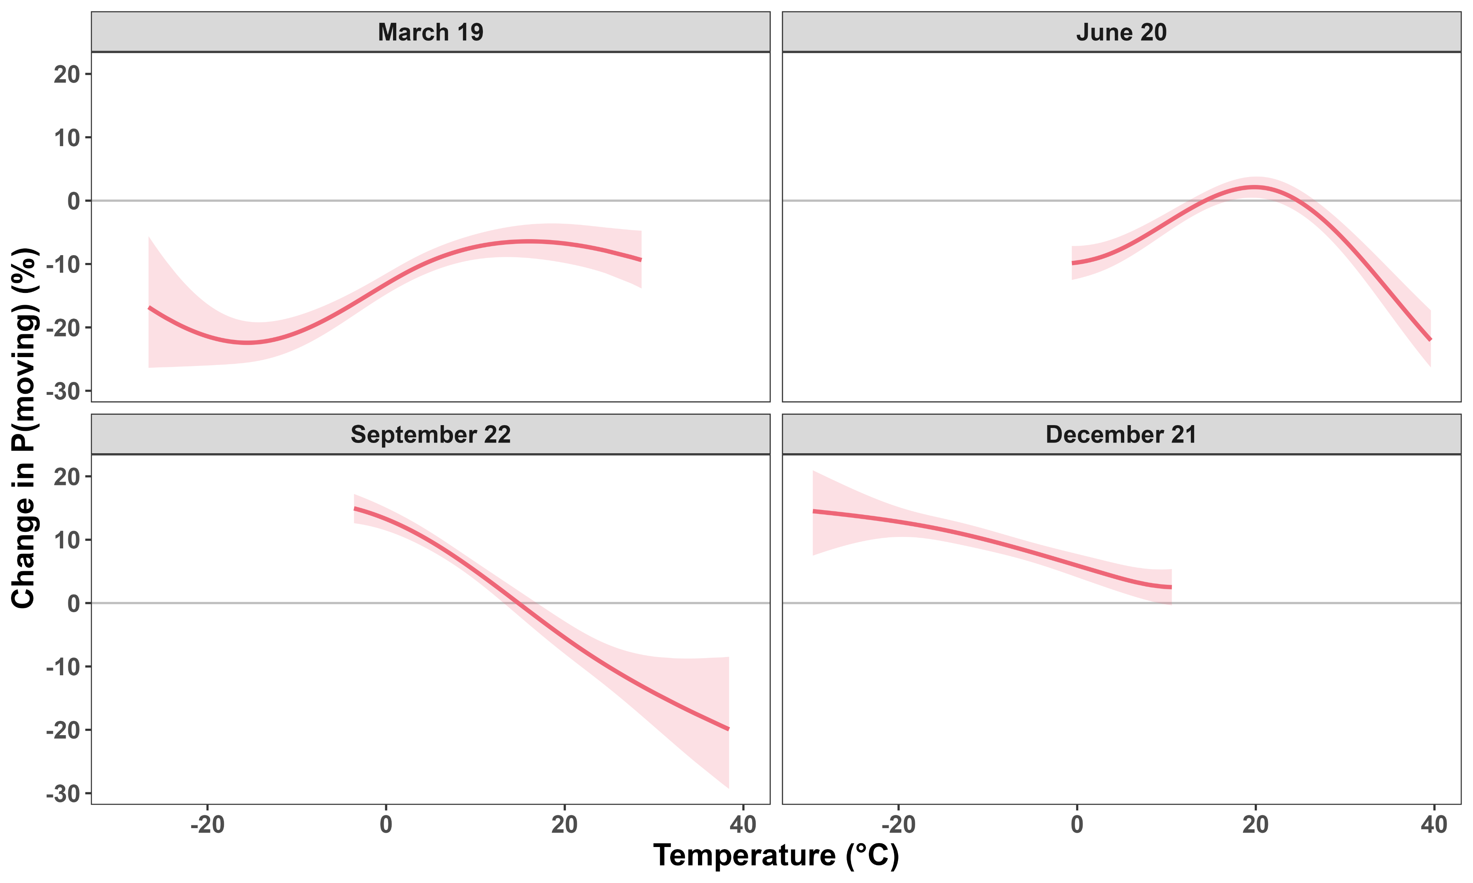
Strong effects of temperature on P(moving)

Slide 16
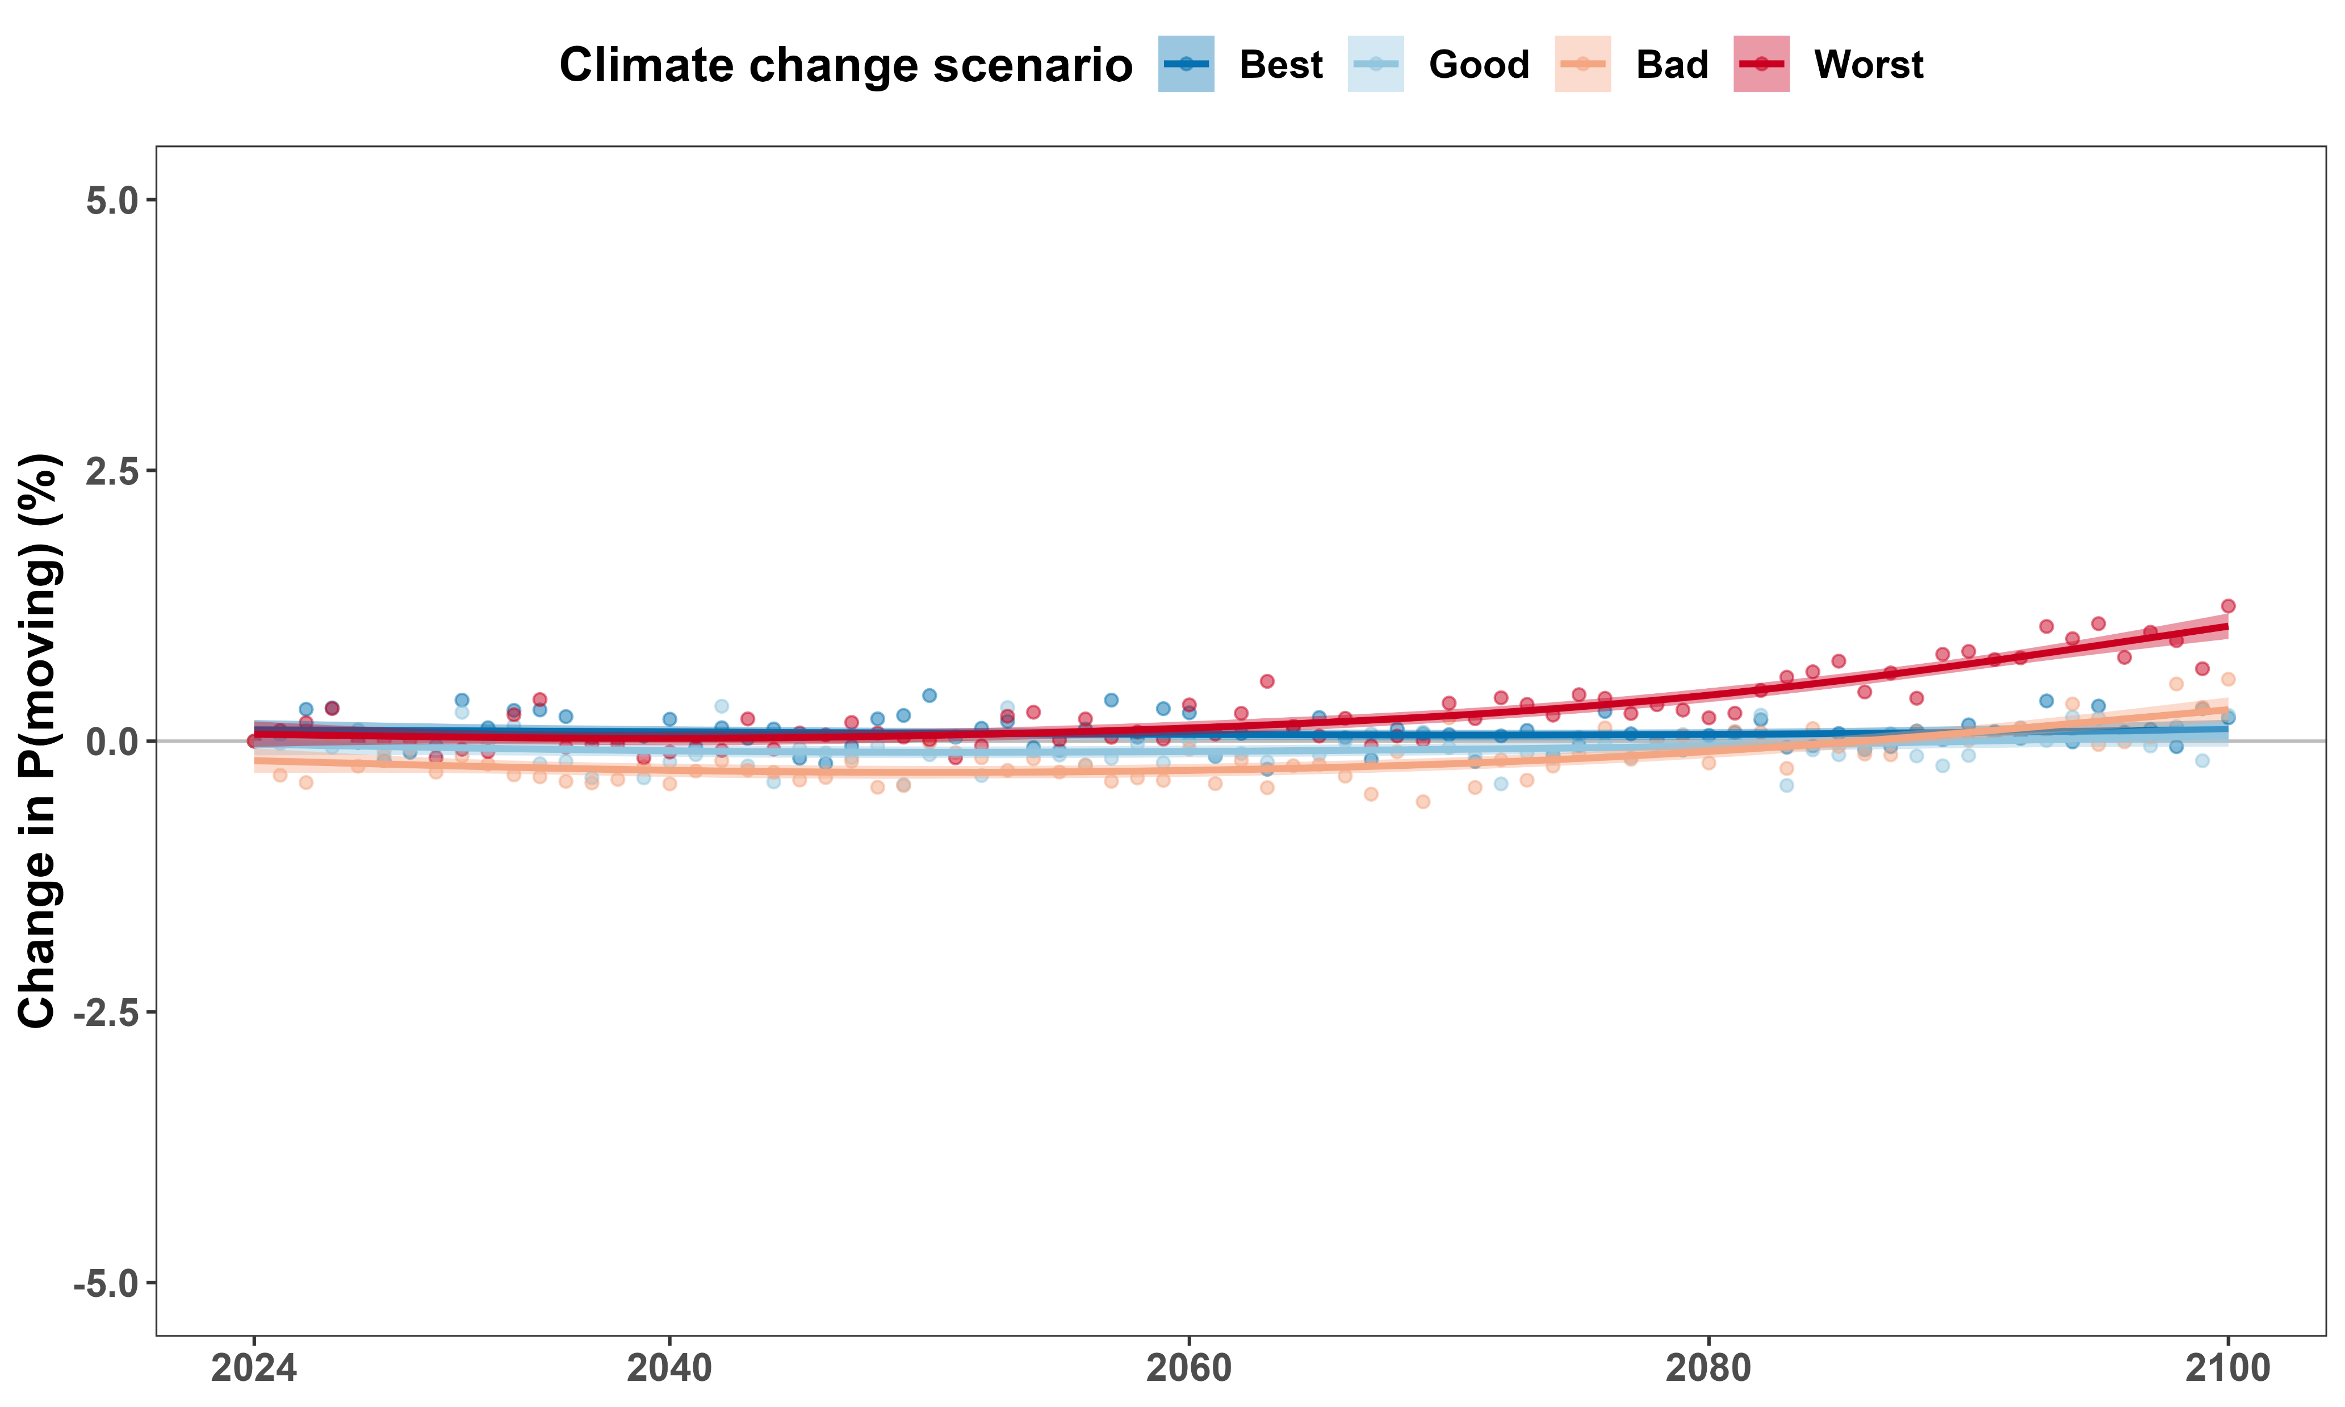
Cannot predict well using monthly average temperature

Slide 17
How does temperature affect how fast boreal caribou move?

Slide 18

Modeling how fast boreal caribou move

Slide 19
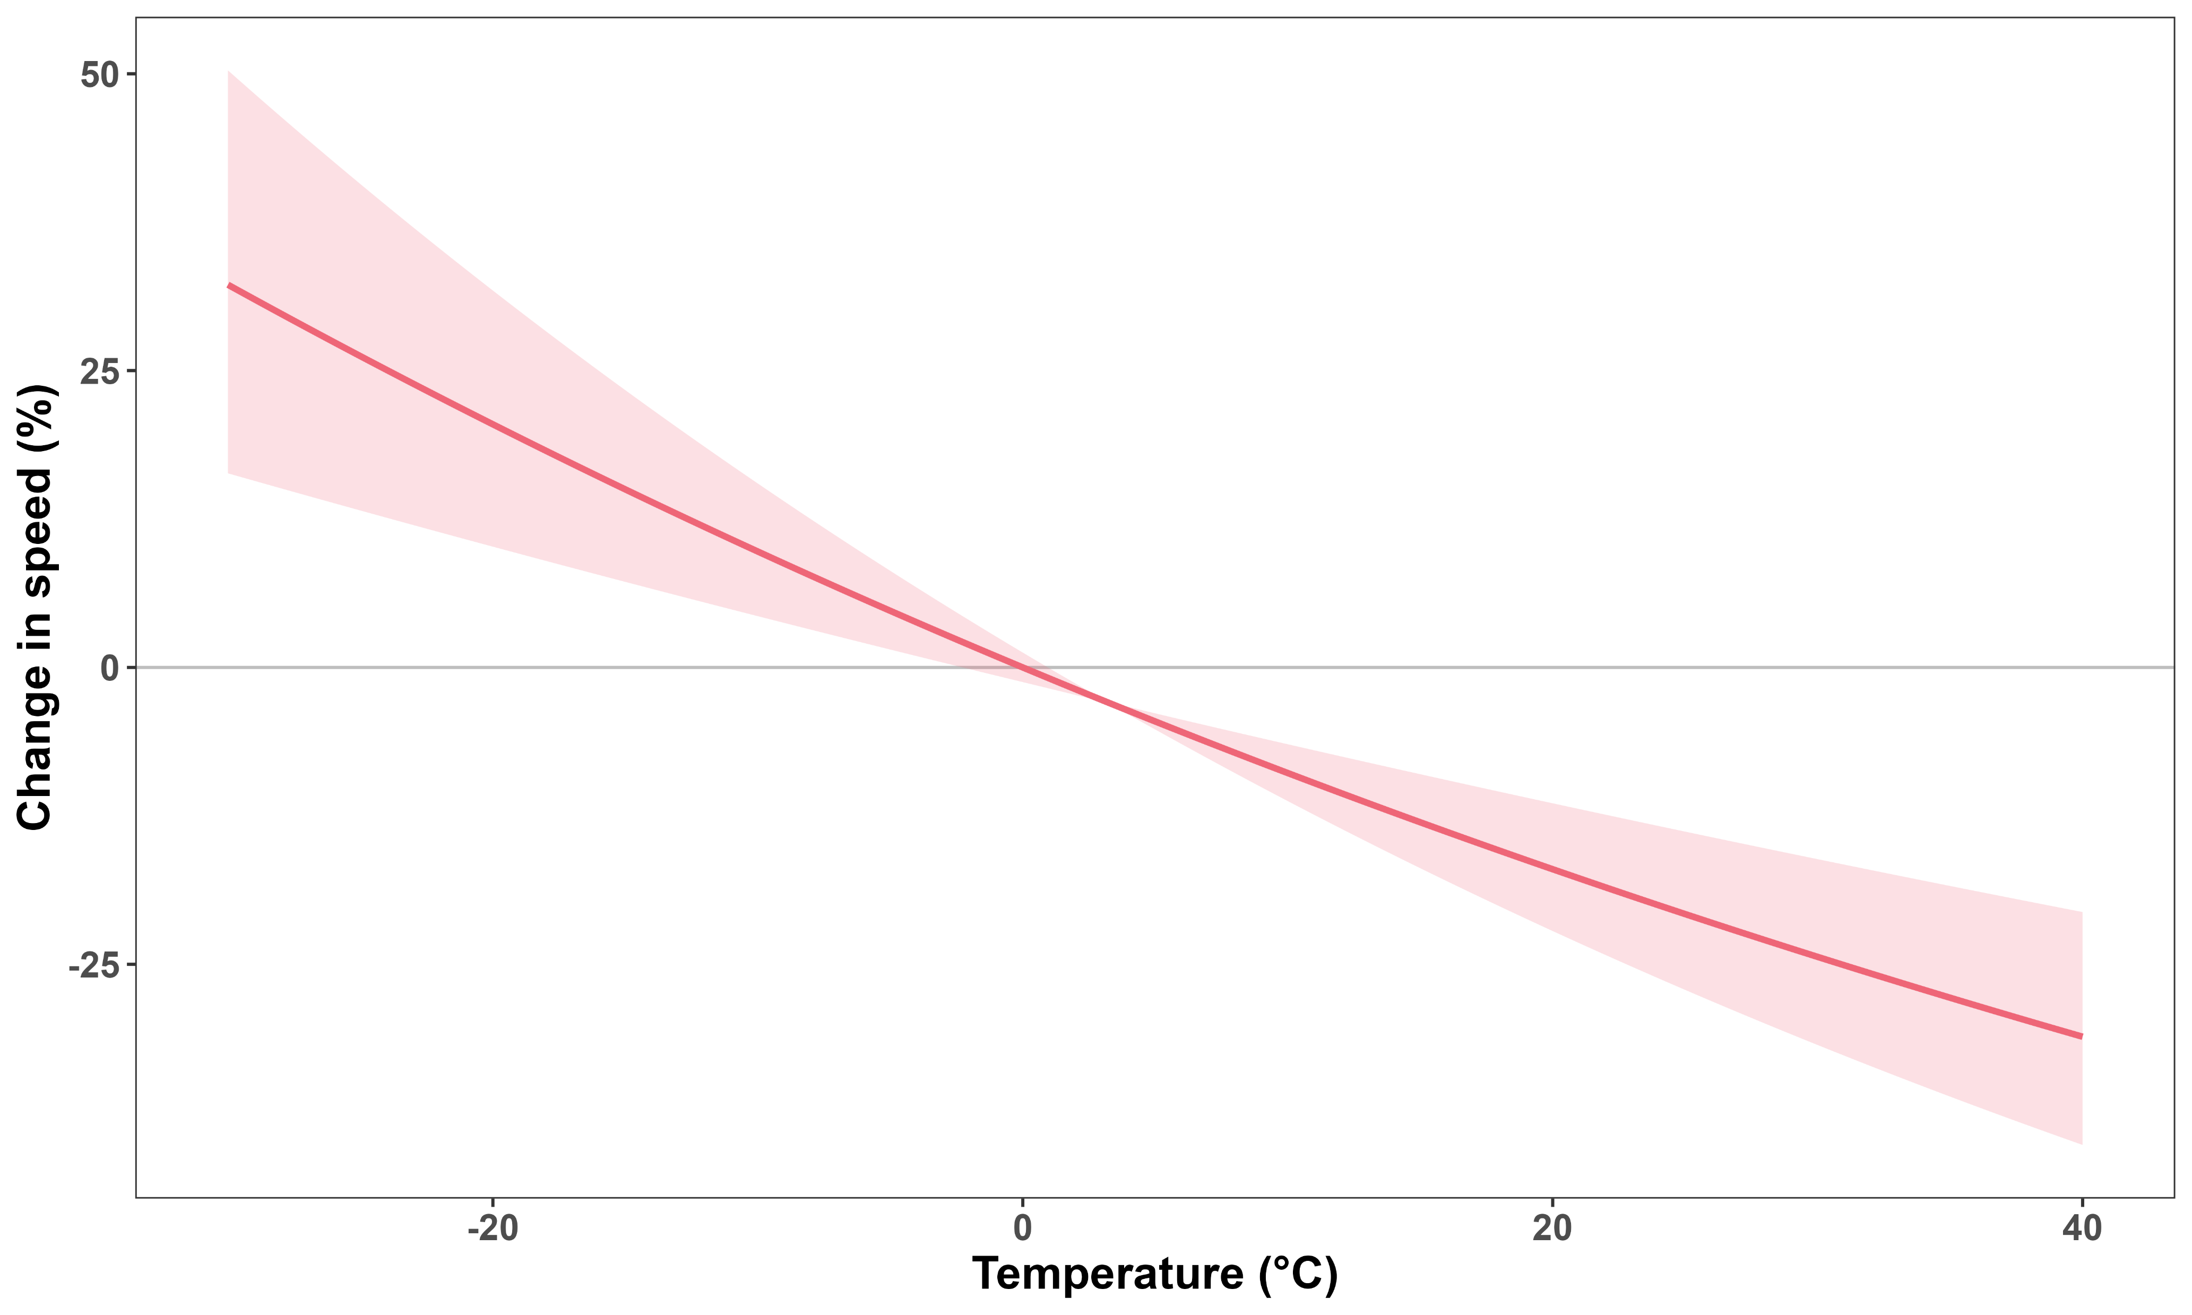
Speed depends strongly on temperature

Slide 20
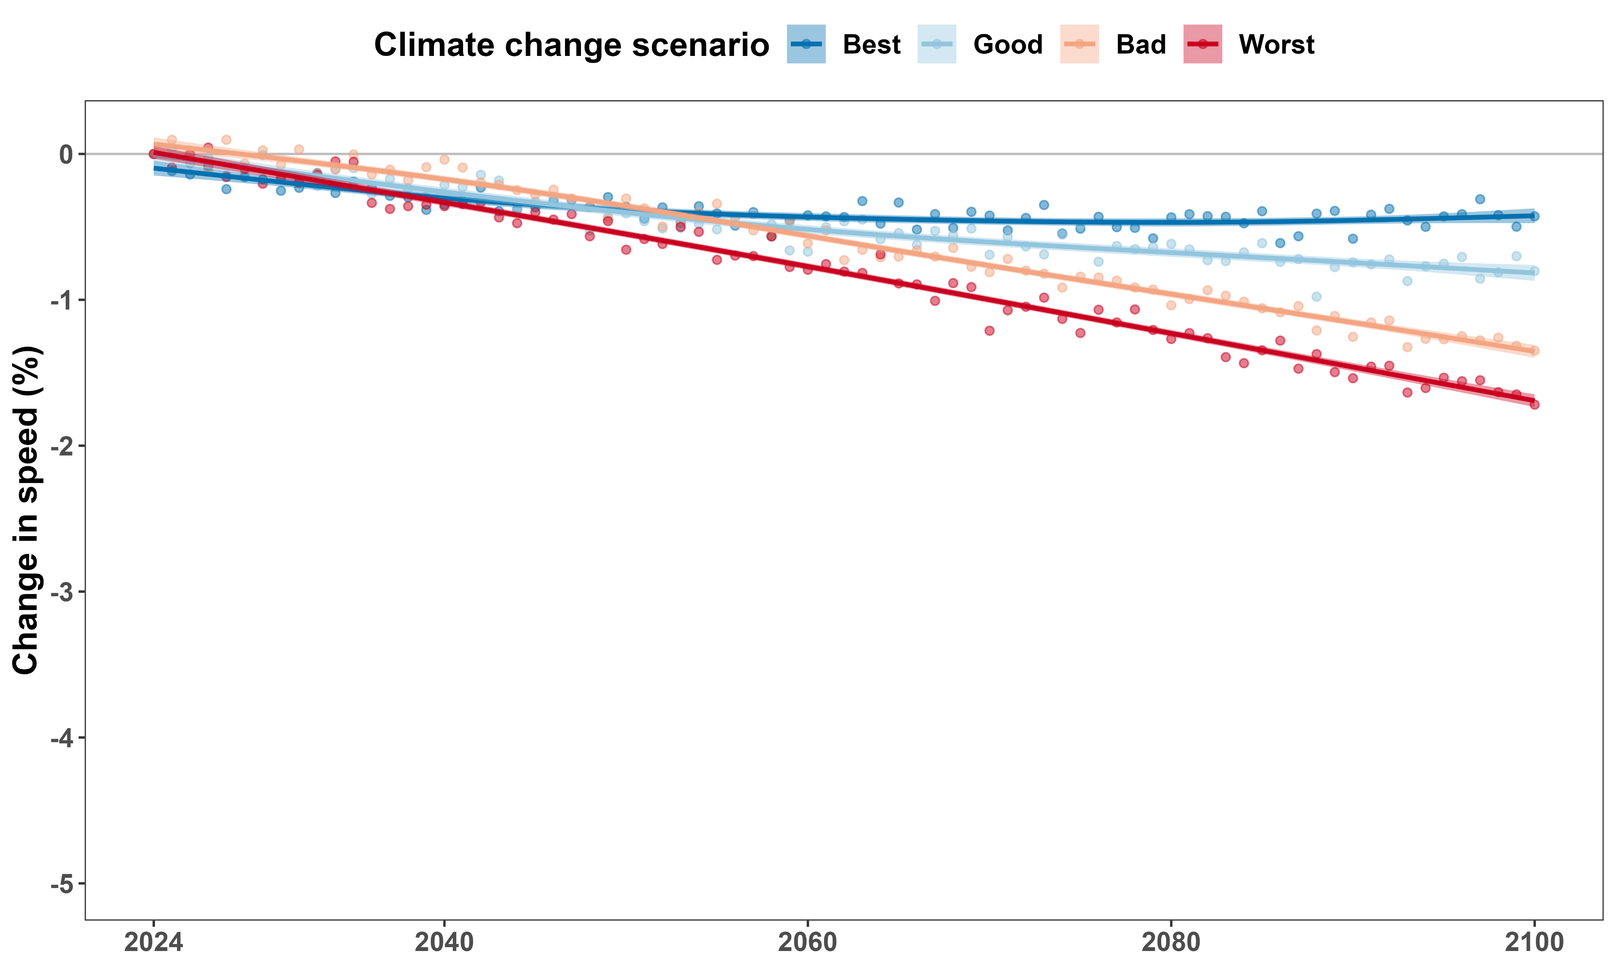
Cannot predict well using monthly average temperature

Slide 21
Temperature and habitat selection

Slide 22
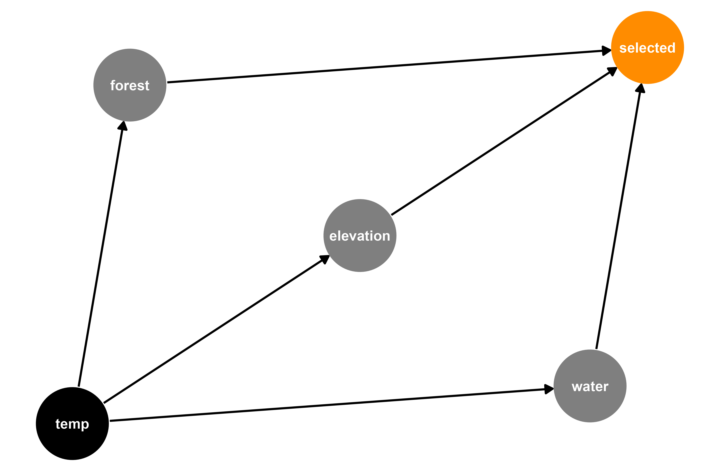



Modeling where boreal caribou move: Resource Selection Function (RSF)

Slide 23
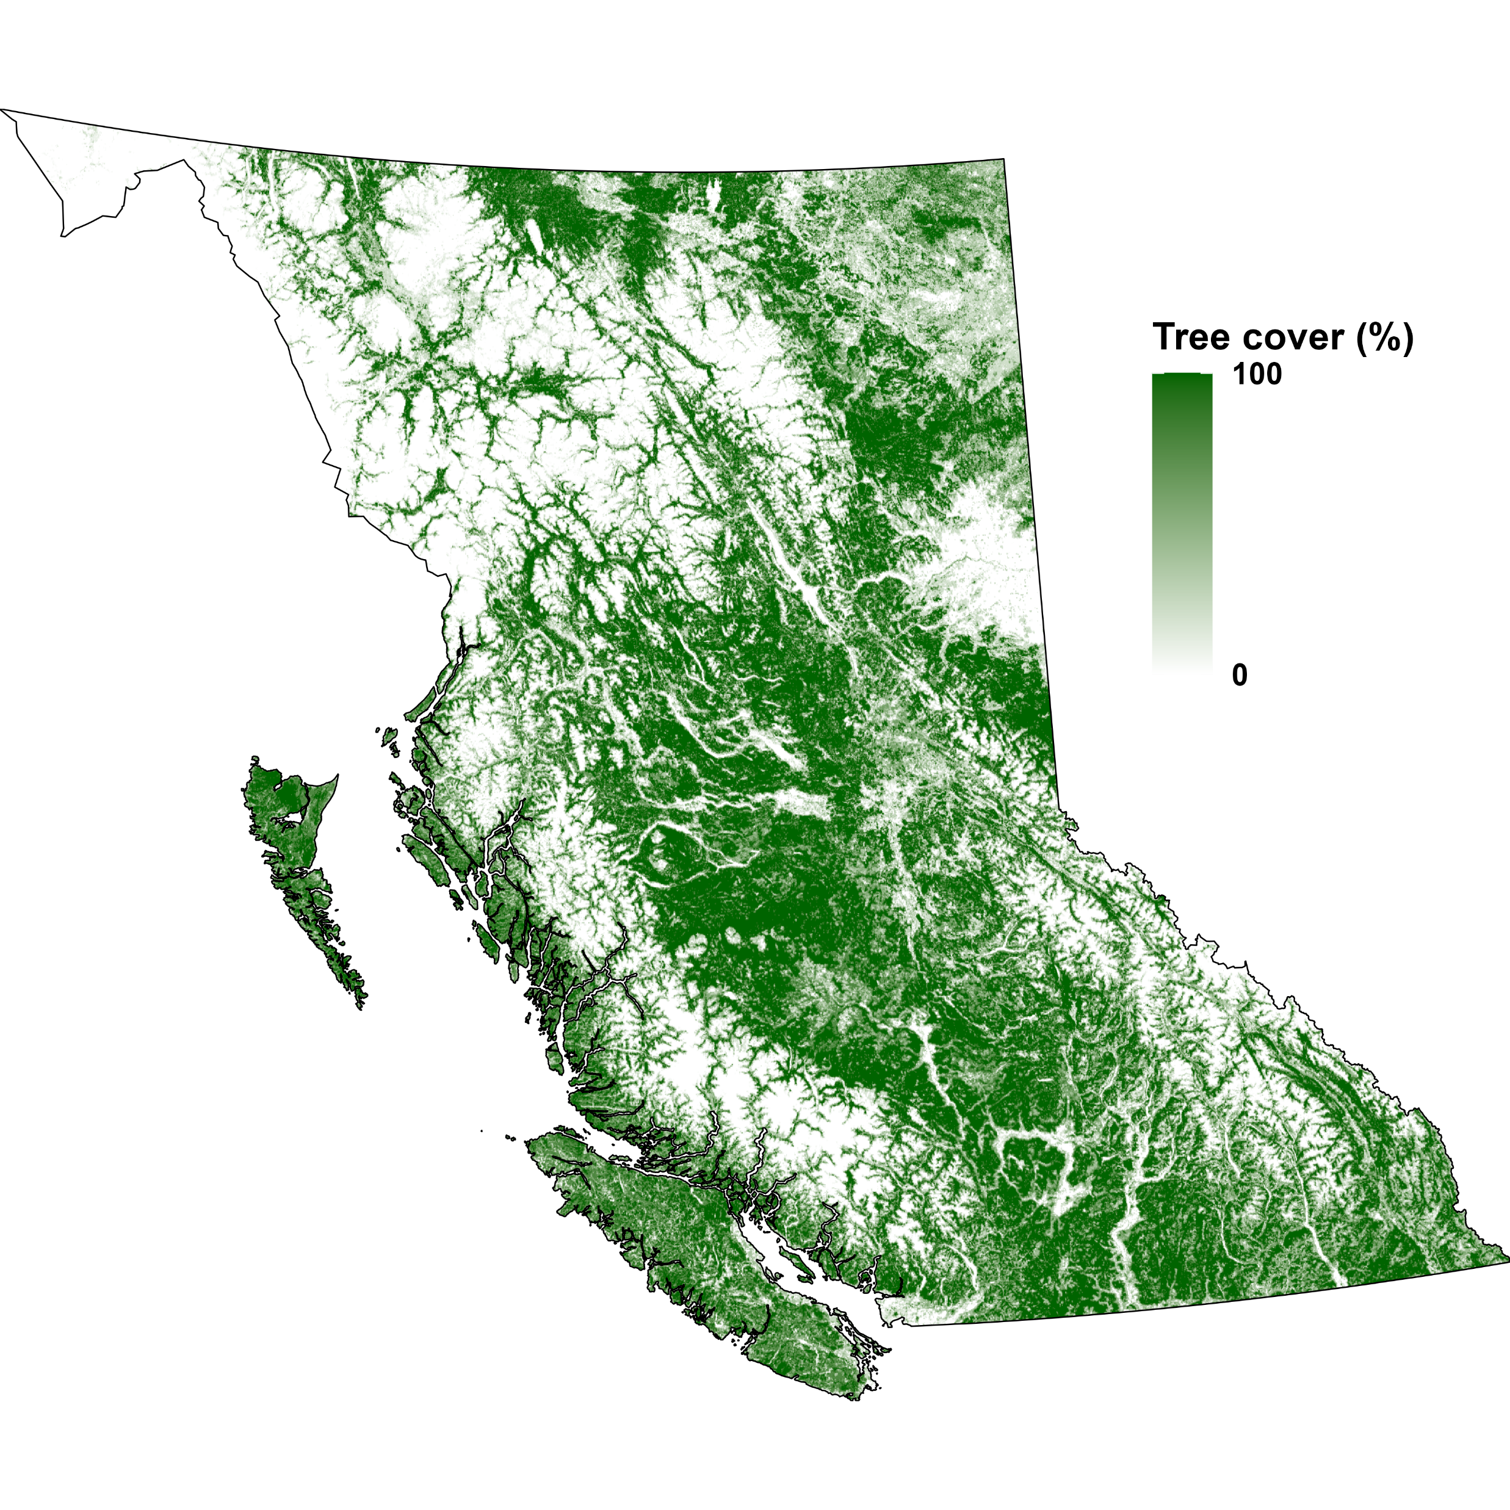
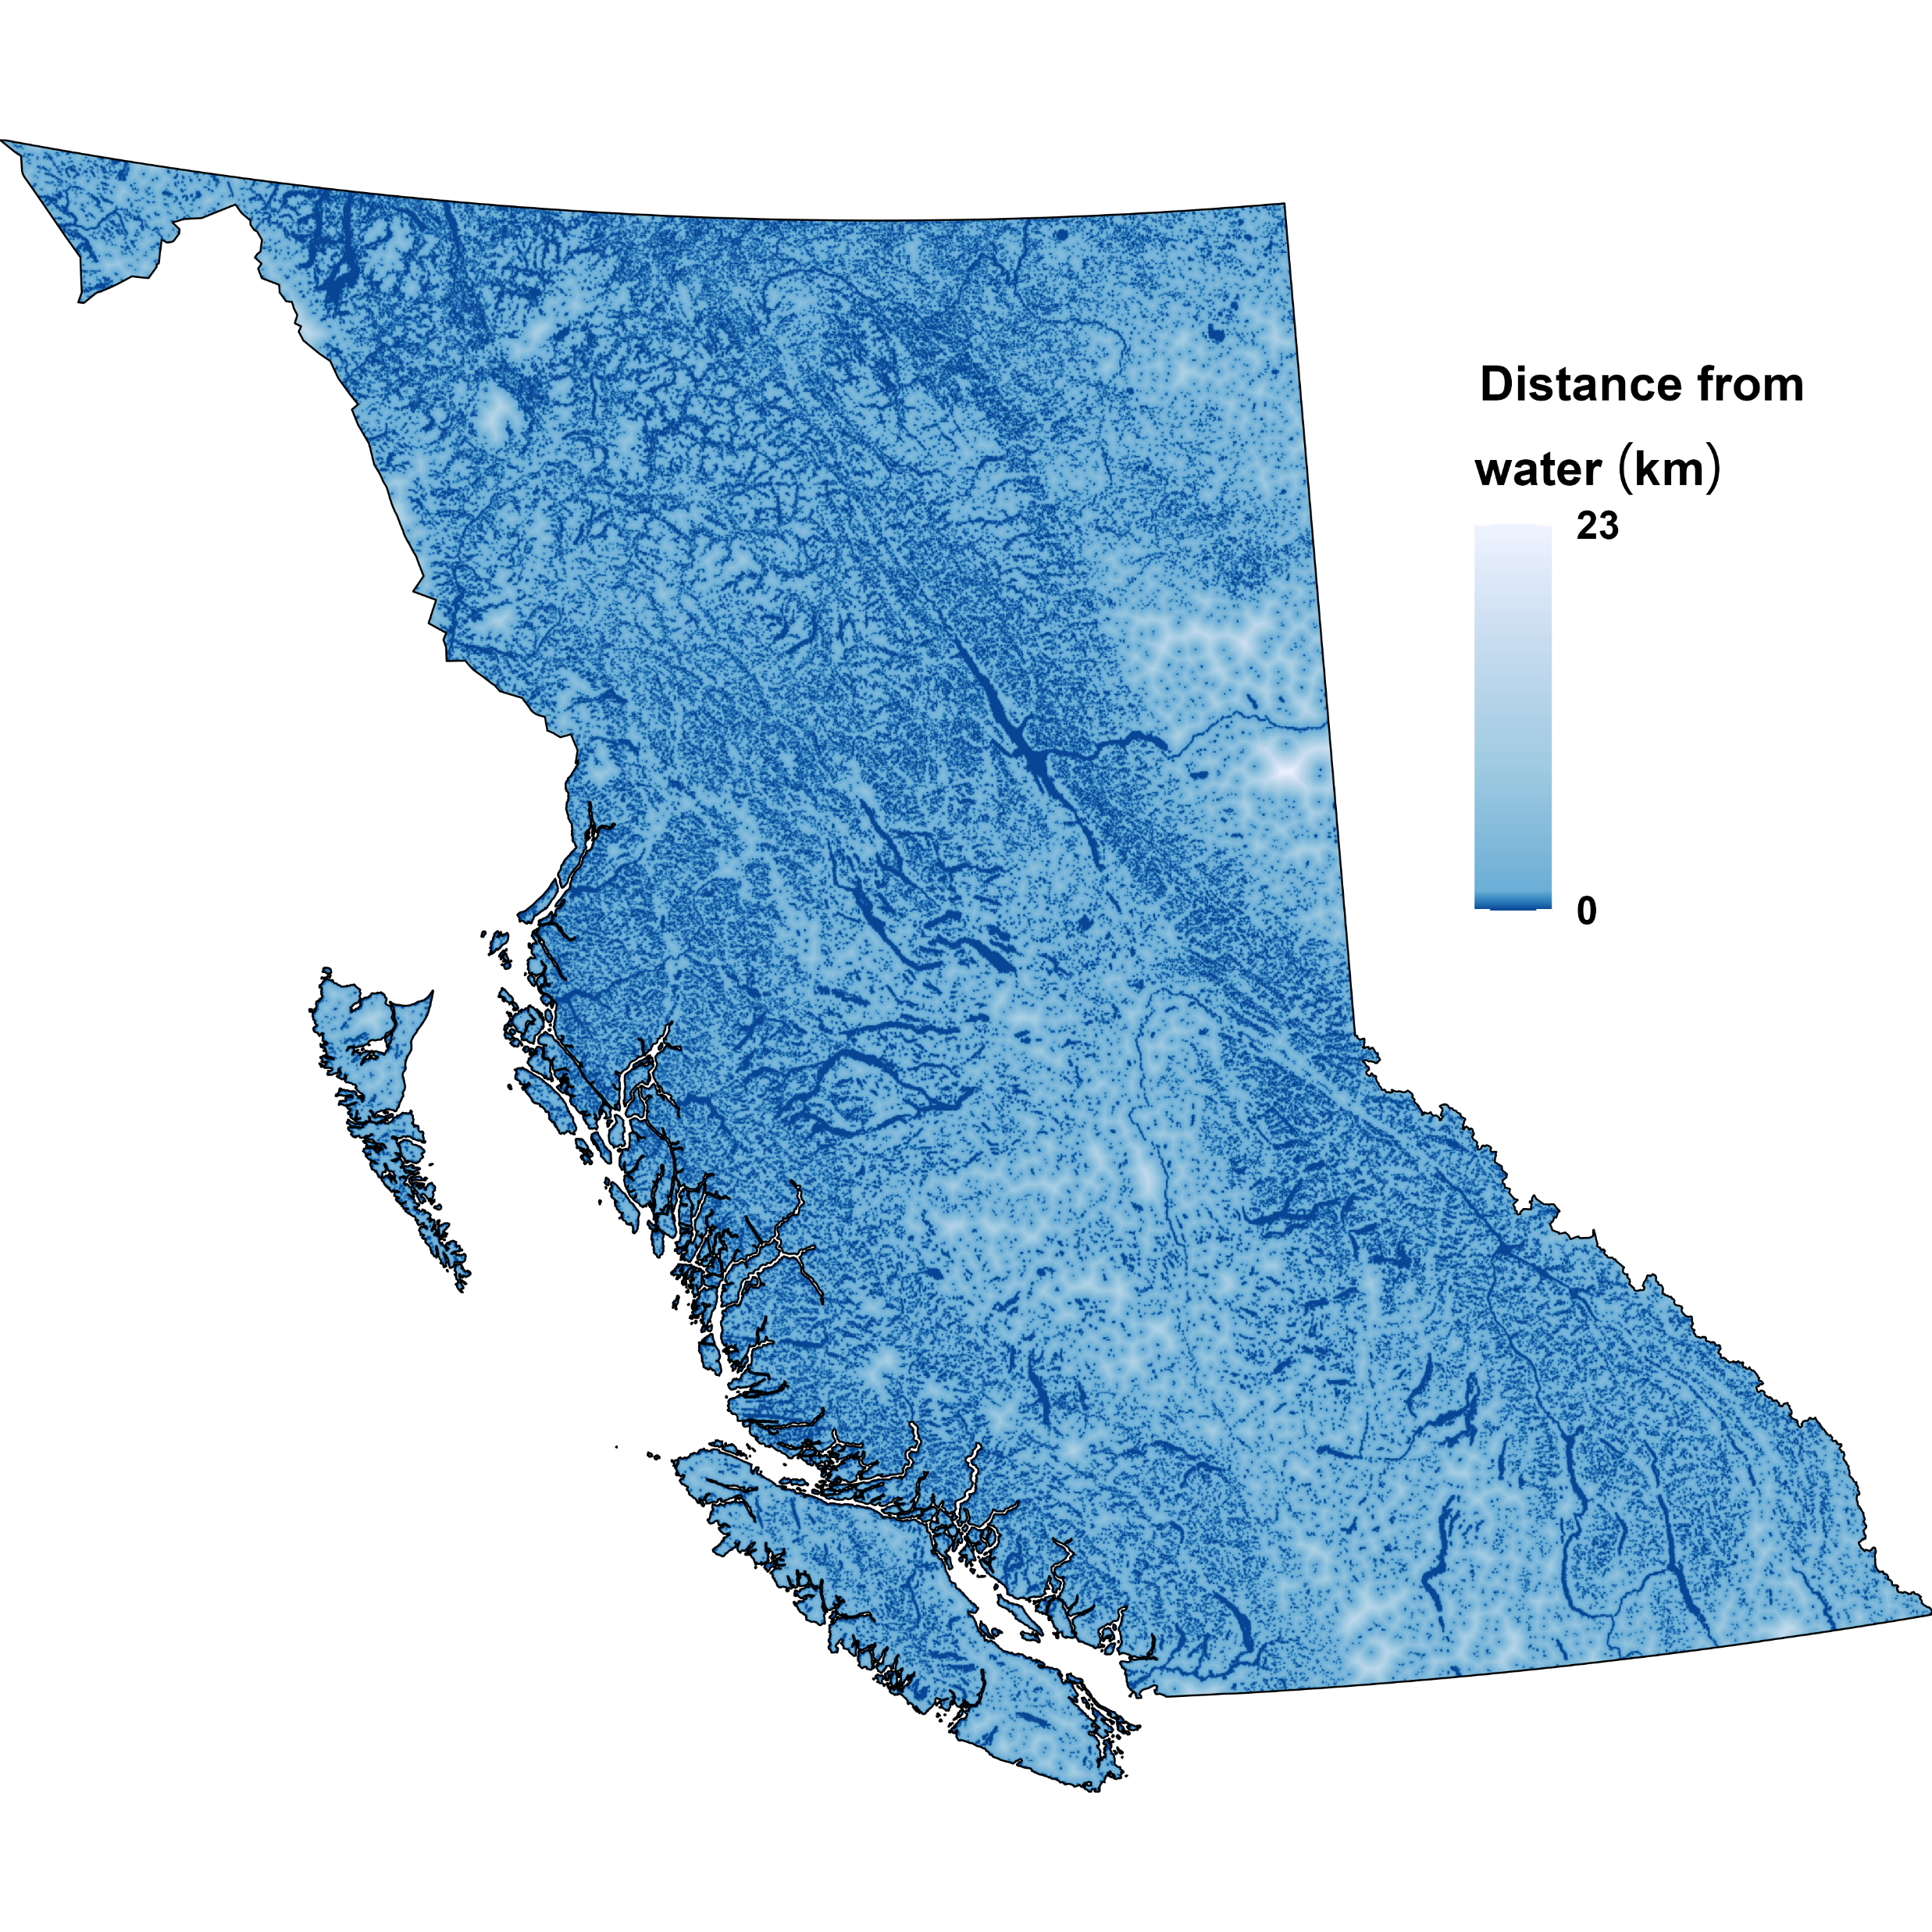
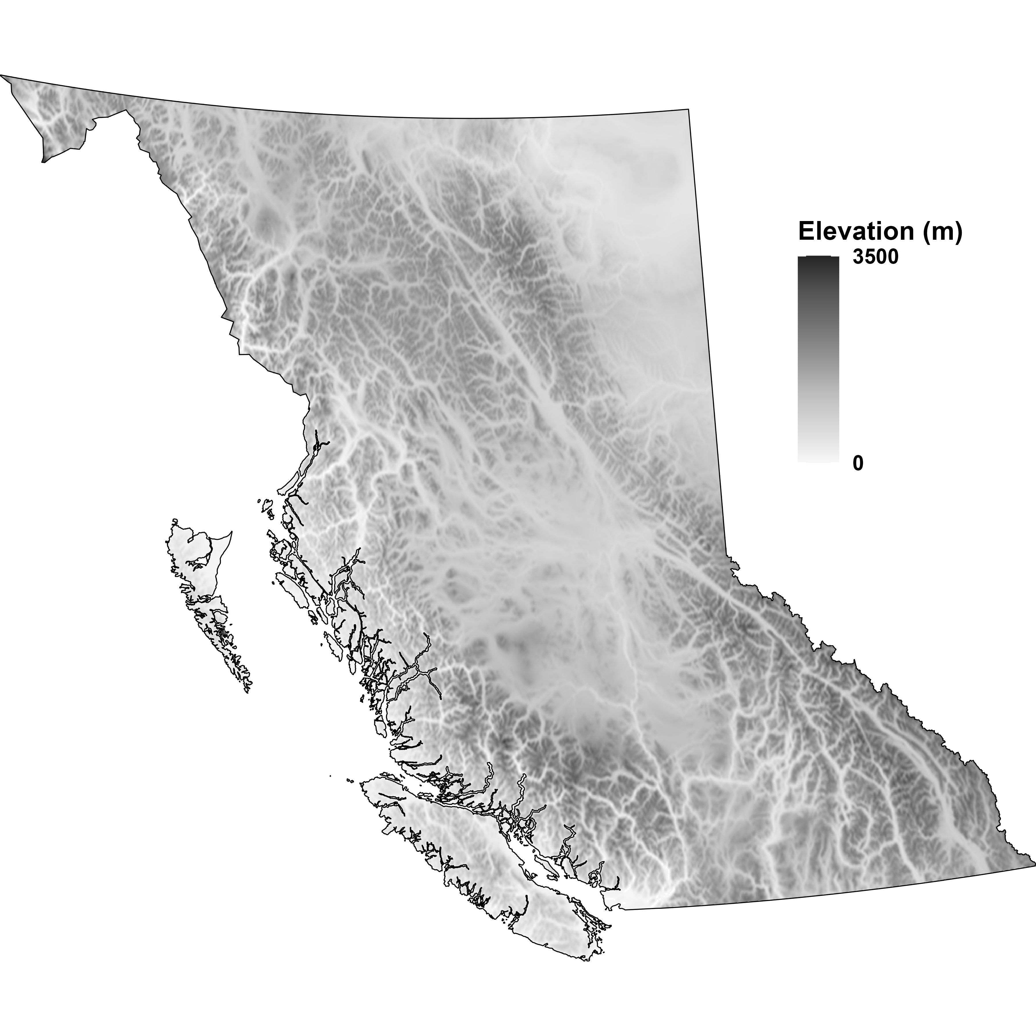

Slide 24
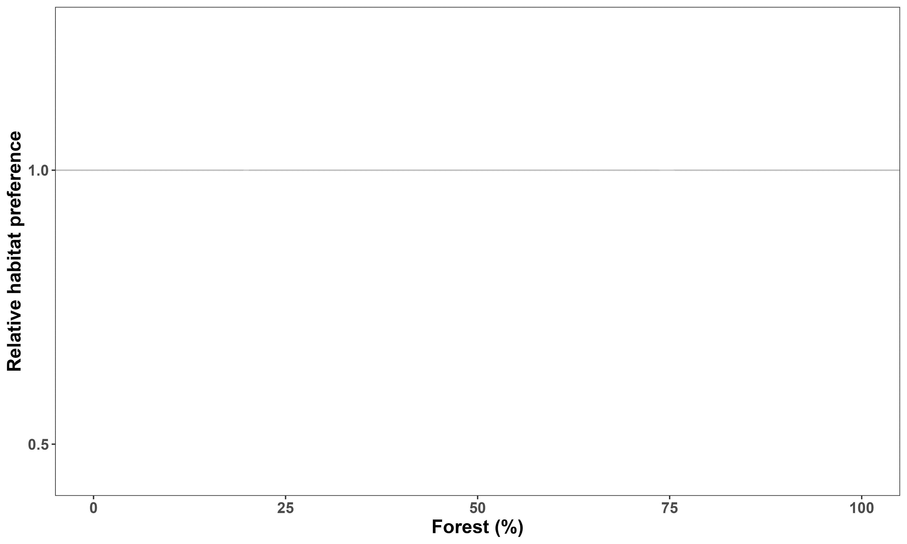

Boreal caribou prefer intermediate forest cover
Like
Dislike

Slide 25
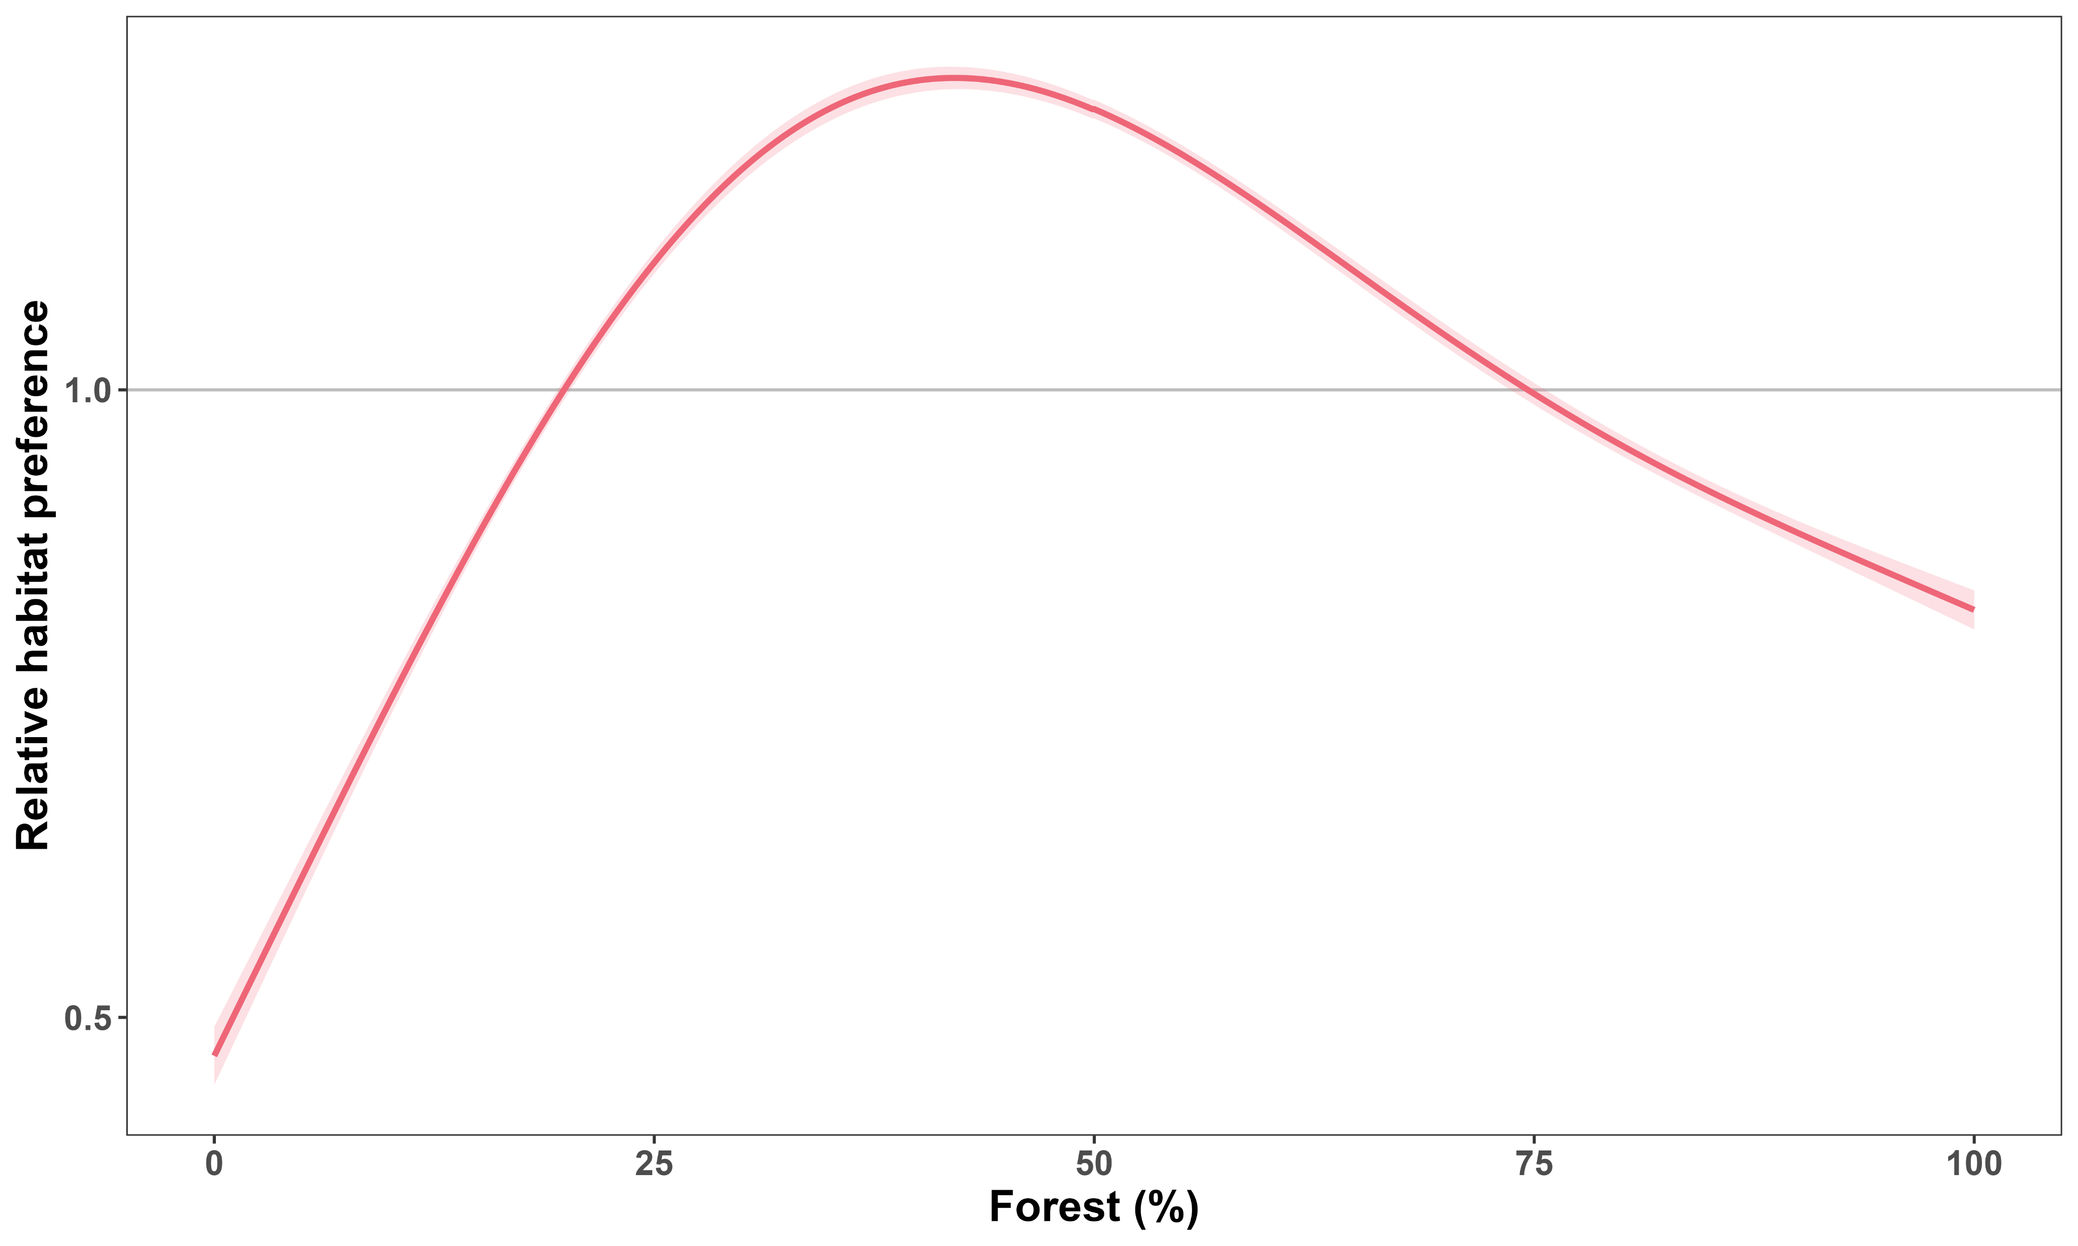
Boreal caribou prefer intermediate forest cover
Like
Dislike

Slide 26
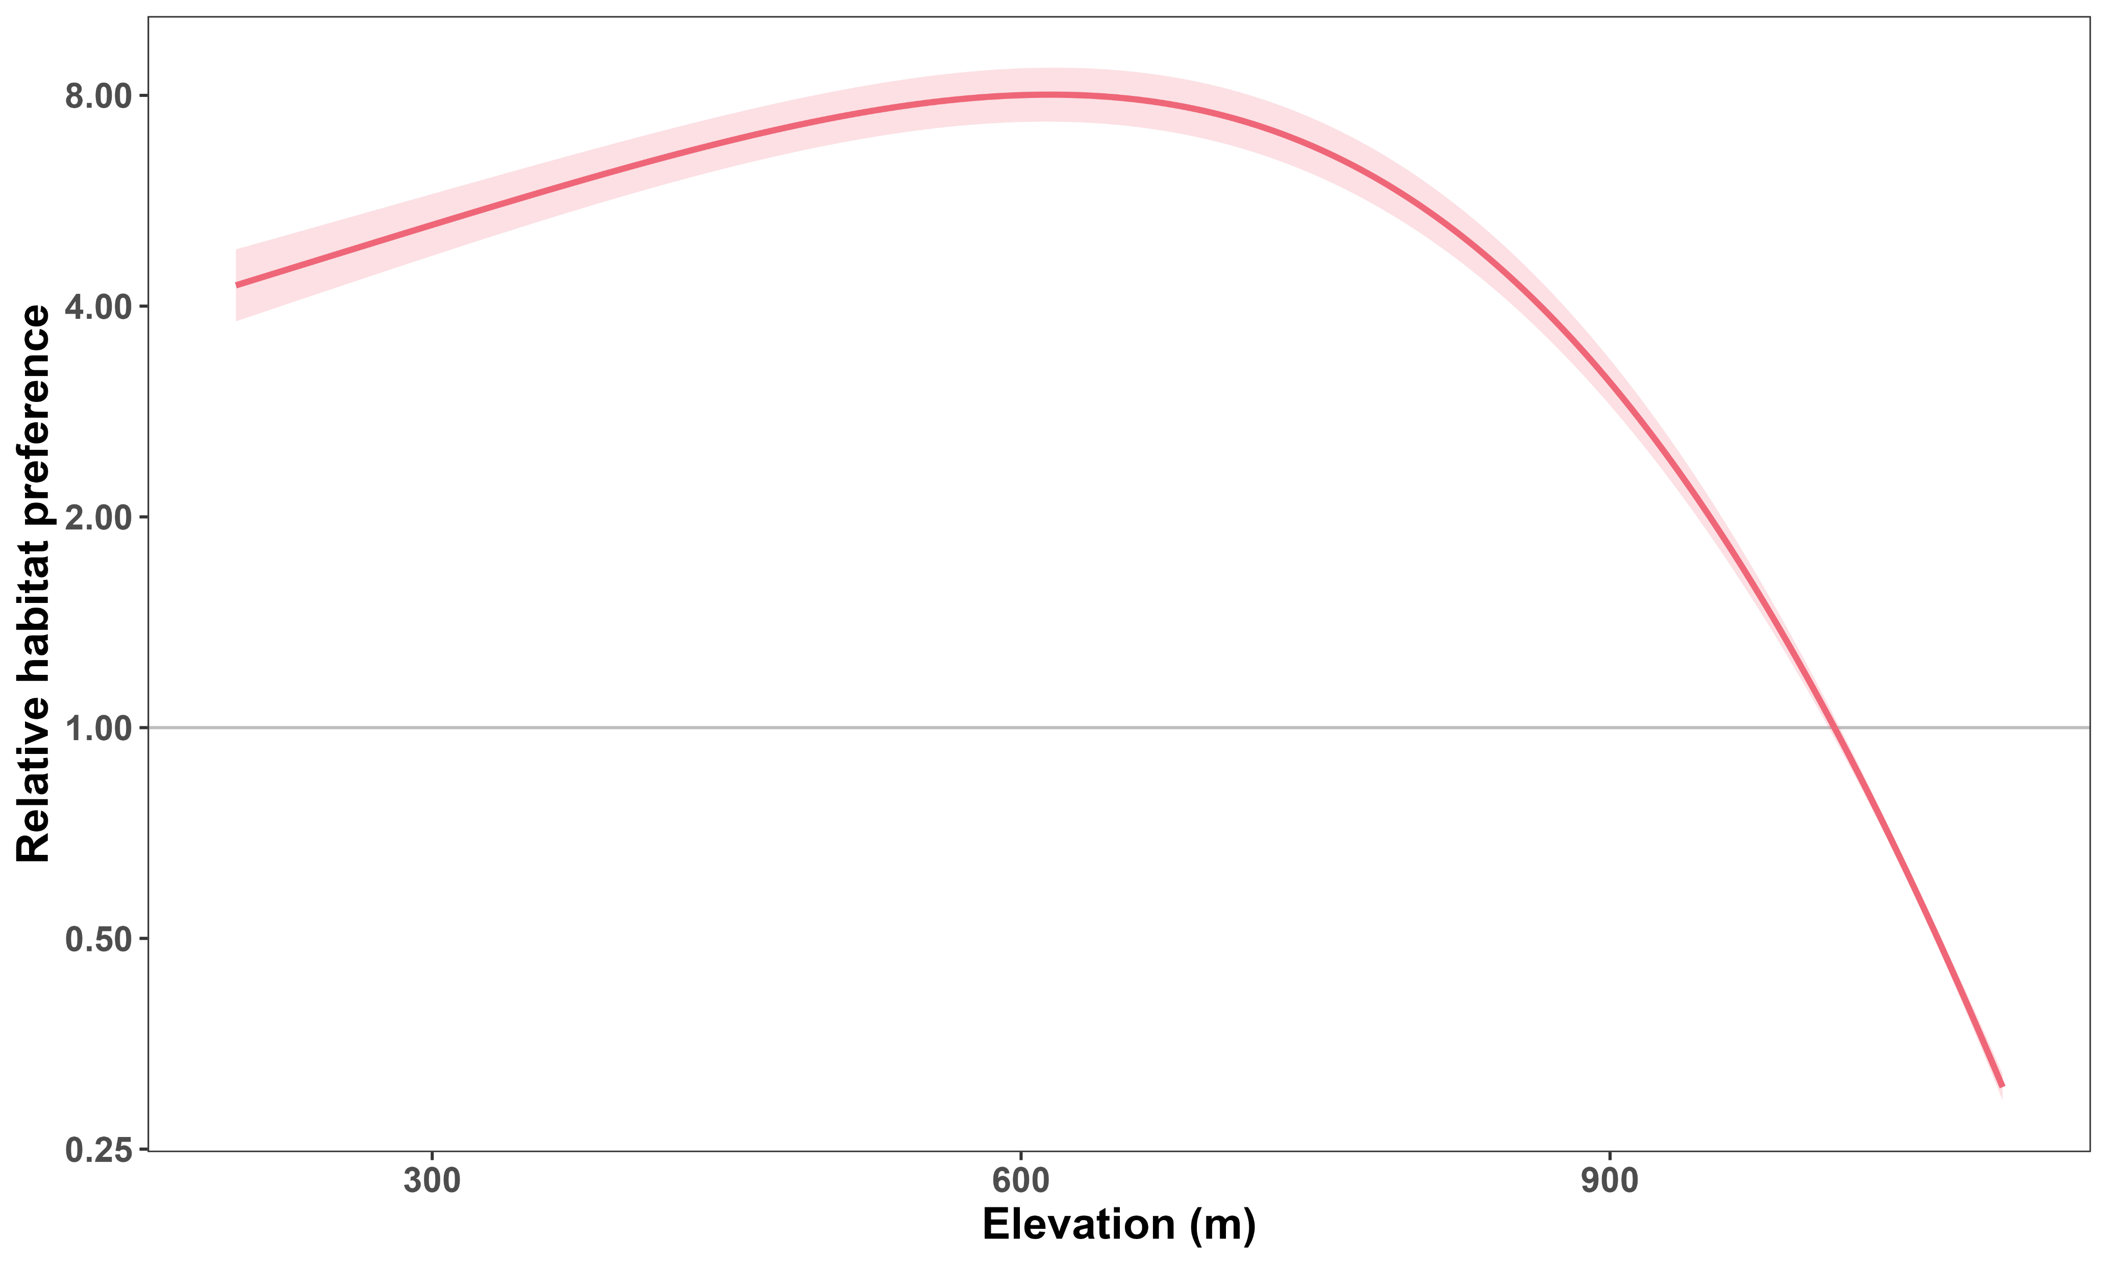

Boreal caribou prefer lower elevations
Like
Dislike

Slide 27
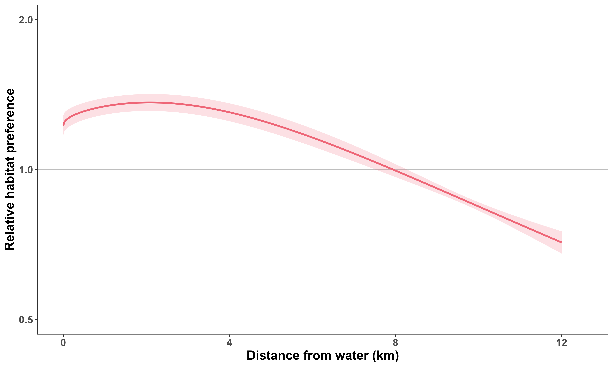

Boreal caribou prefer being near water
Like
Dislike

Slide 28


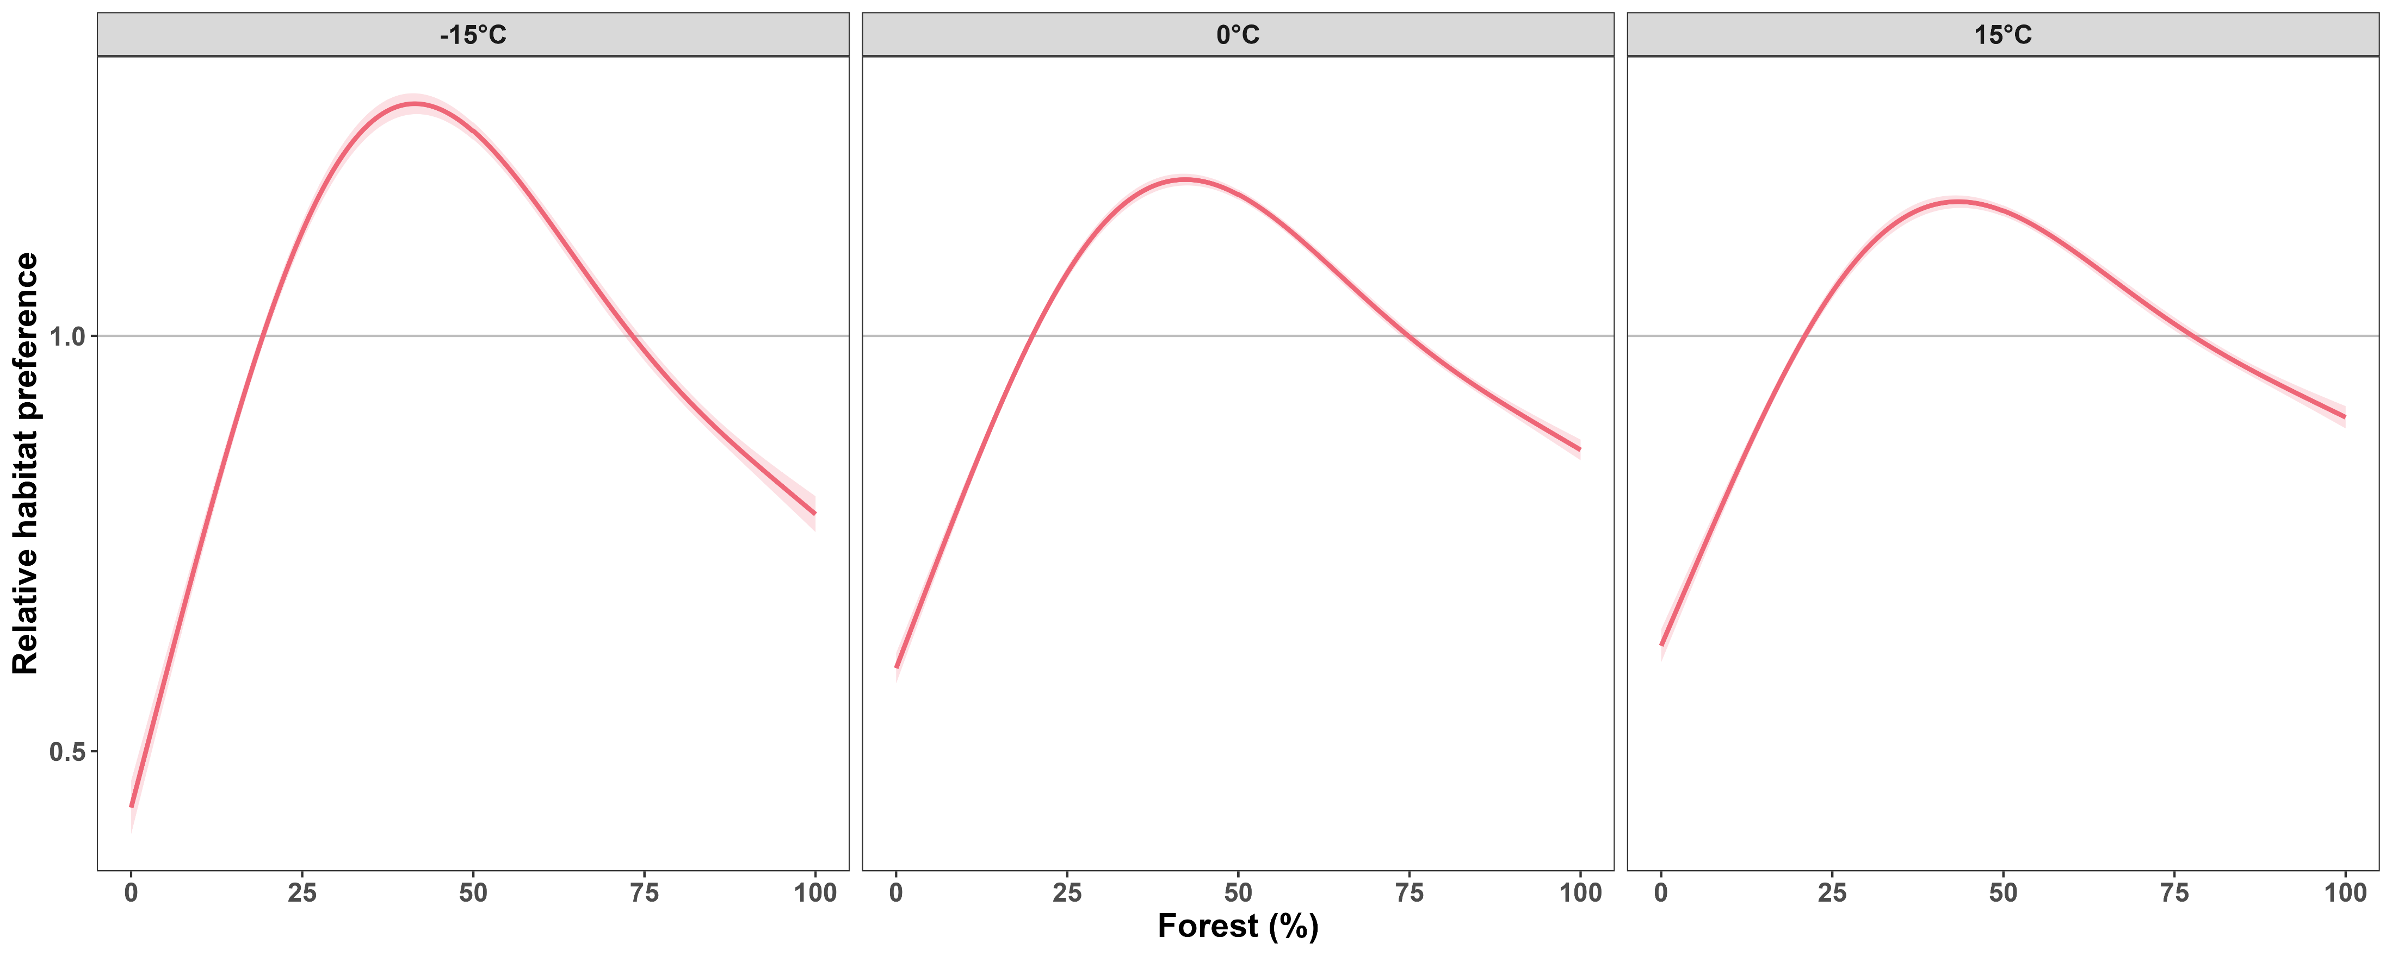
Forest preference is weaker at warmer temperatures

Slide 29
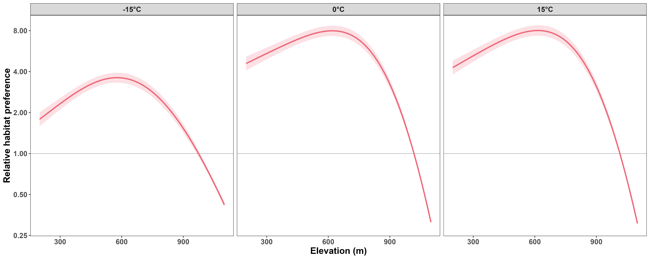
Boreal caribou avoid high elevation more at warmer temperatures

Slide 30
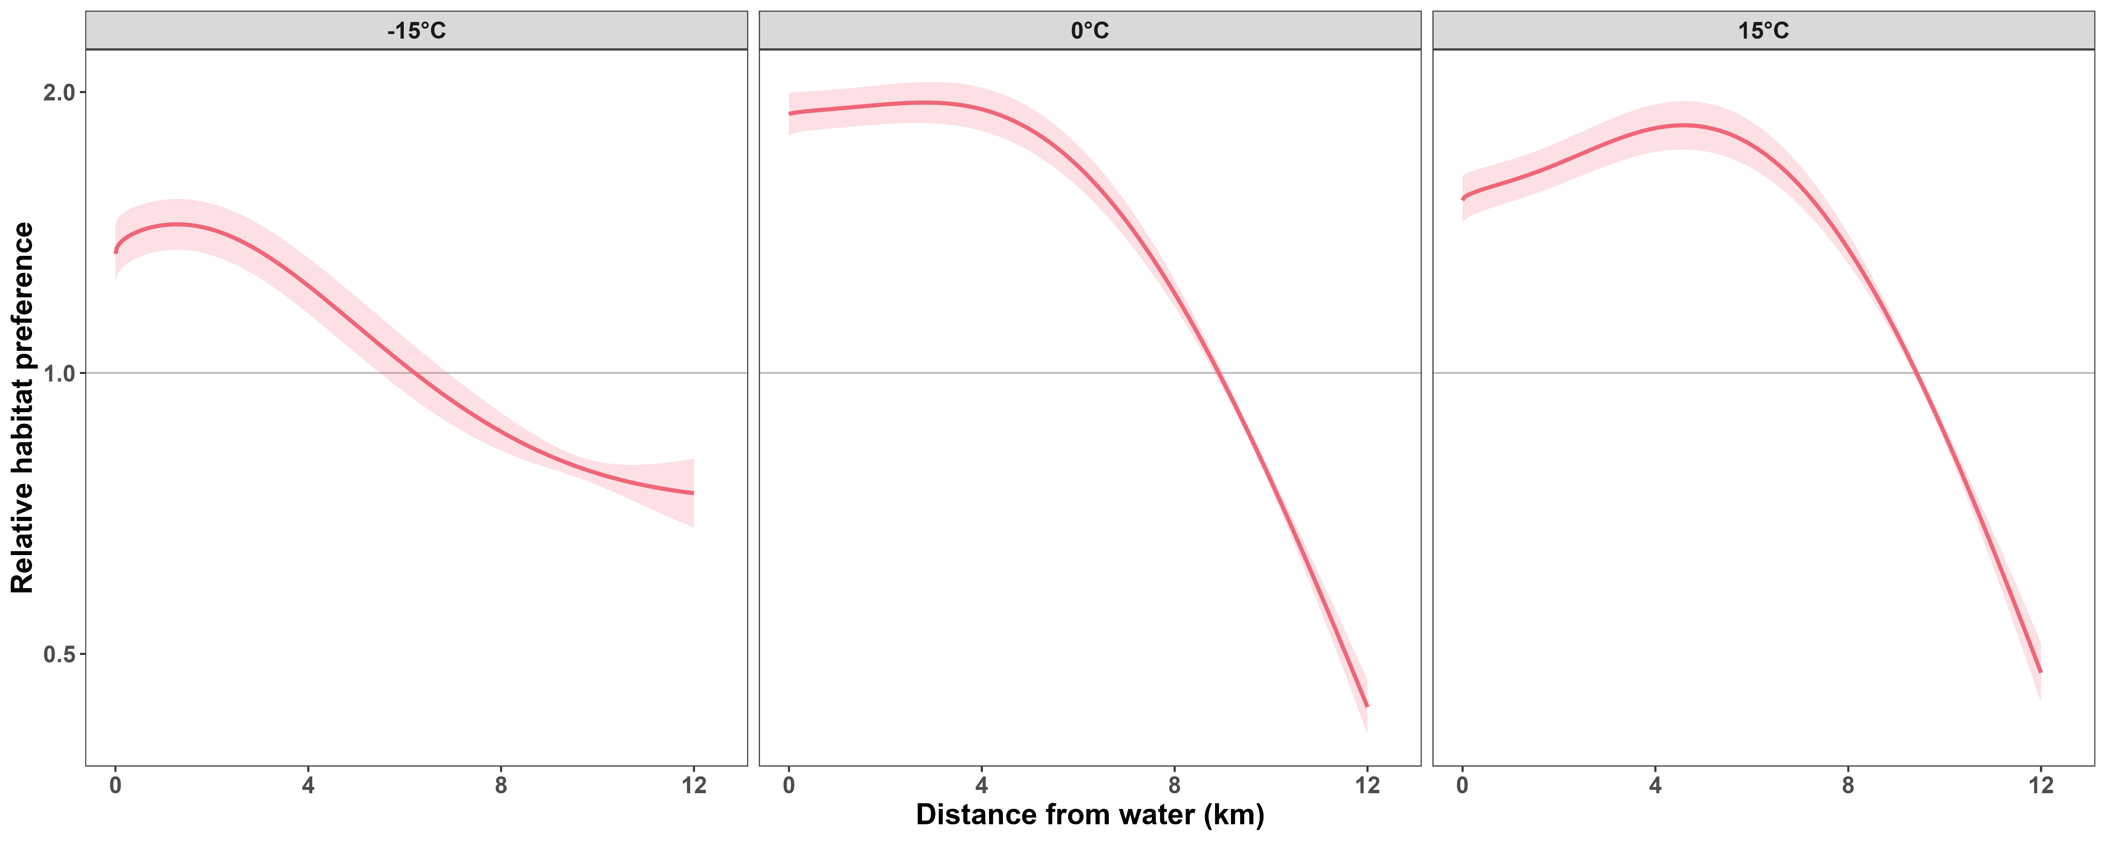
Boreal caribou stay closer to water at warmer temperatures

Slide 31
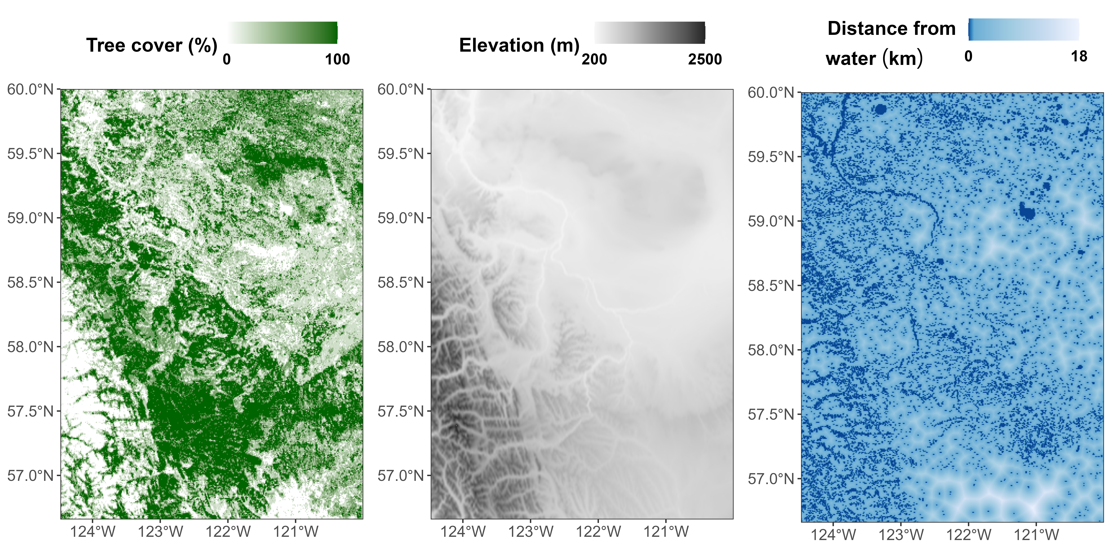
Predicting within the current range

Slide 32
Habitat preference depends strongly on temperature

Slide 33
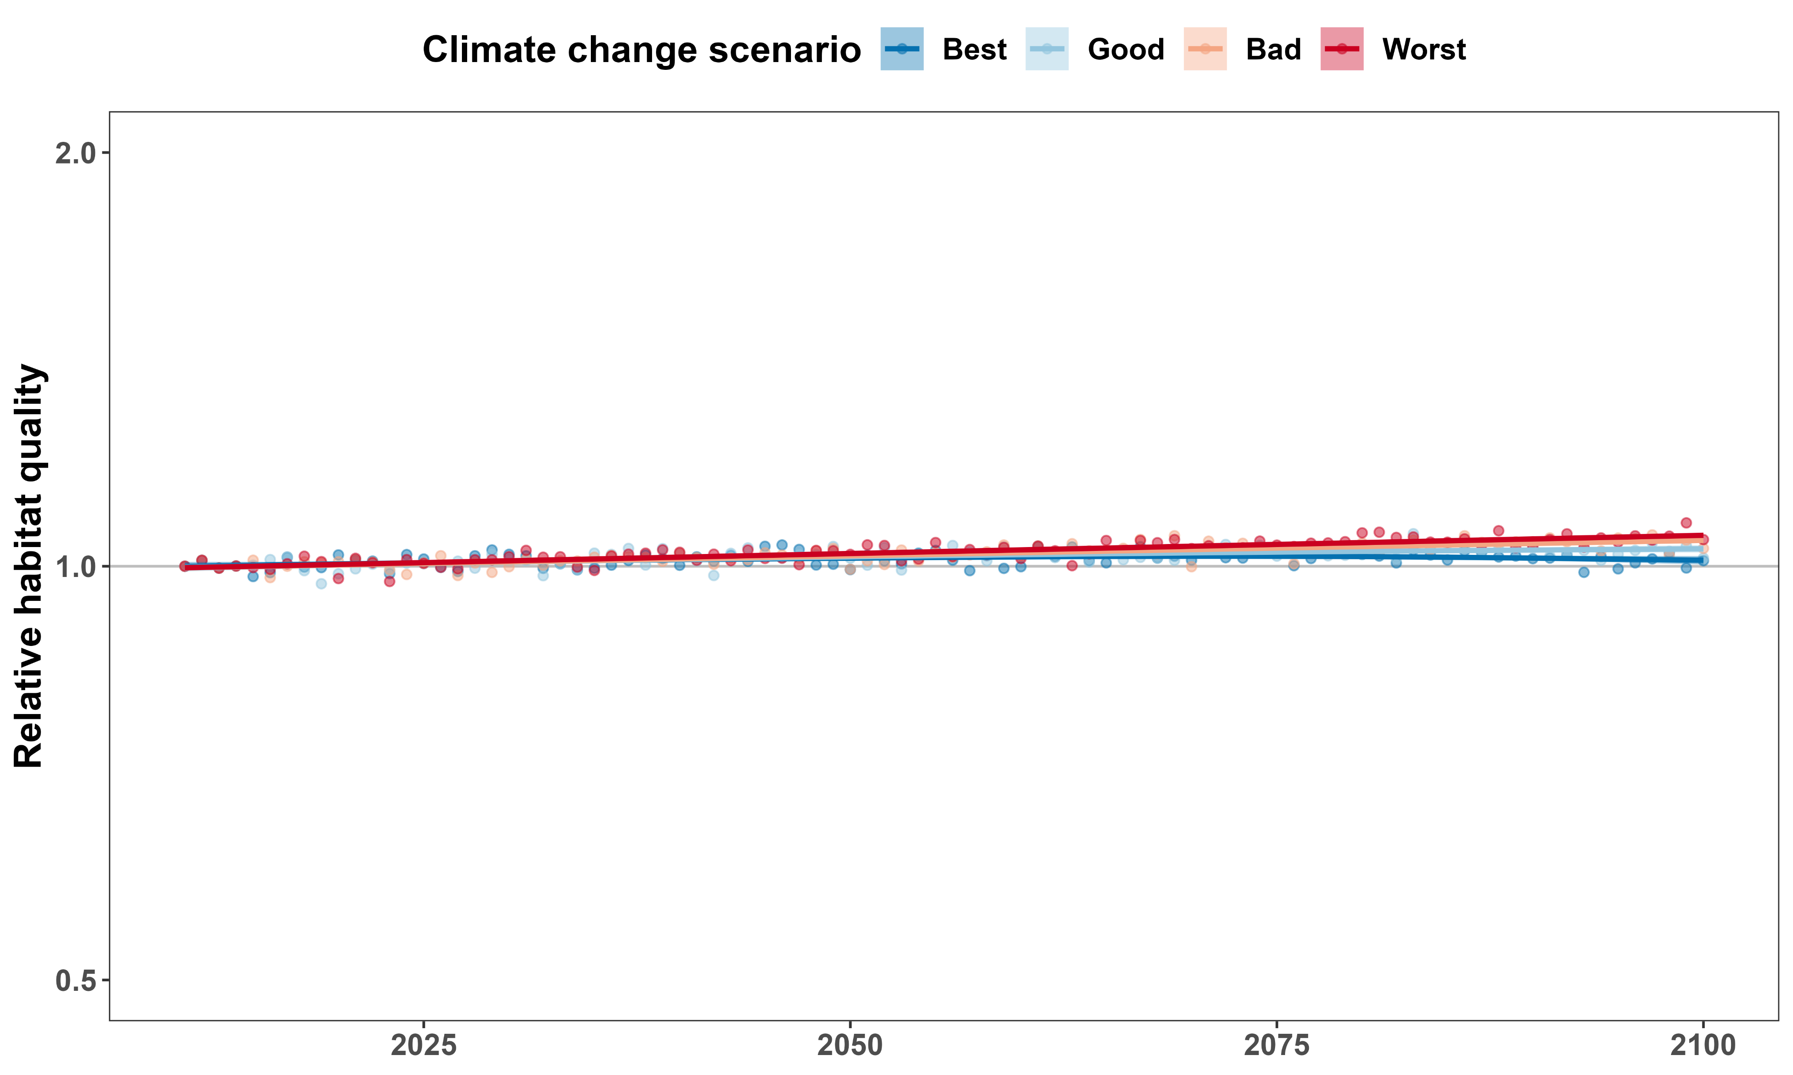
Cannot predict well using monthly average temperature
Like
Dislike

Slide 35
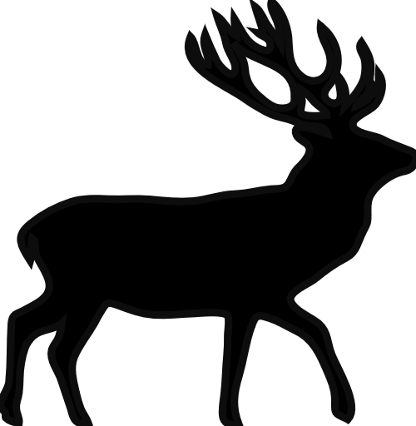
Consequences for conservation
We cannot predict future movement with monthly temperatures:
Need simulations of daily weather
Protect areas proactively
May need to change current protected areas

Slide 36







Acknowledgements

Slide 37
Consequences for conservation
We cannot predict future movement with monthly temperatures:
Need simulations of daily weather
Protect areas proactively
May need to adapt current protected areas

Slide 38
References and credits
Aerial photo of Okanagan Lake: © University of British Columbia Okanagan
Picture of frozen Okanagan Lake: © Kelowna Public Archives: KPA #487
Cougar phylopic: CC BY-NC 3.0: Cristian Osorio & Paula Carrera, Proyecto Carnivoros Australes
Mountain goat phylopic: CC-BY-SA 3.0: Sarah E. Haworth
R code can be found at https://github.com/QuantitativeEcologyLab/bc-mammals-speeds/

Slide 39
Additional slides

Slide 40
Smooth effects of model 1 (movement frequency)

Slide 41
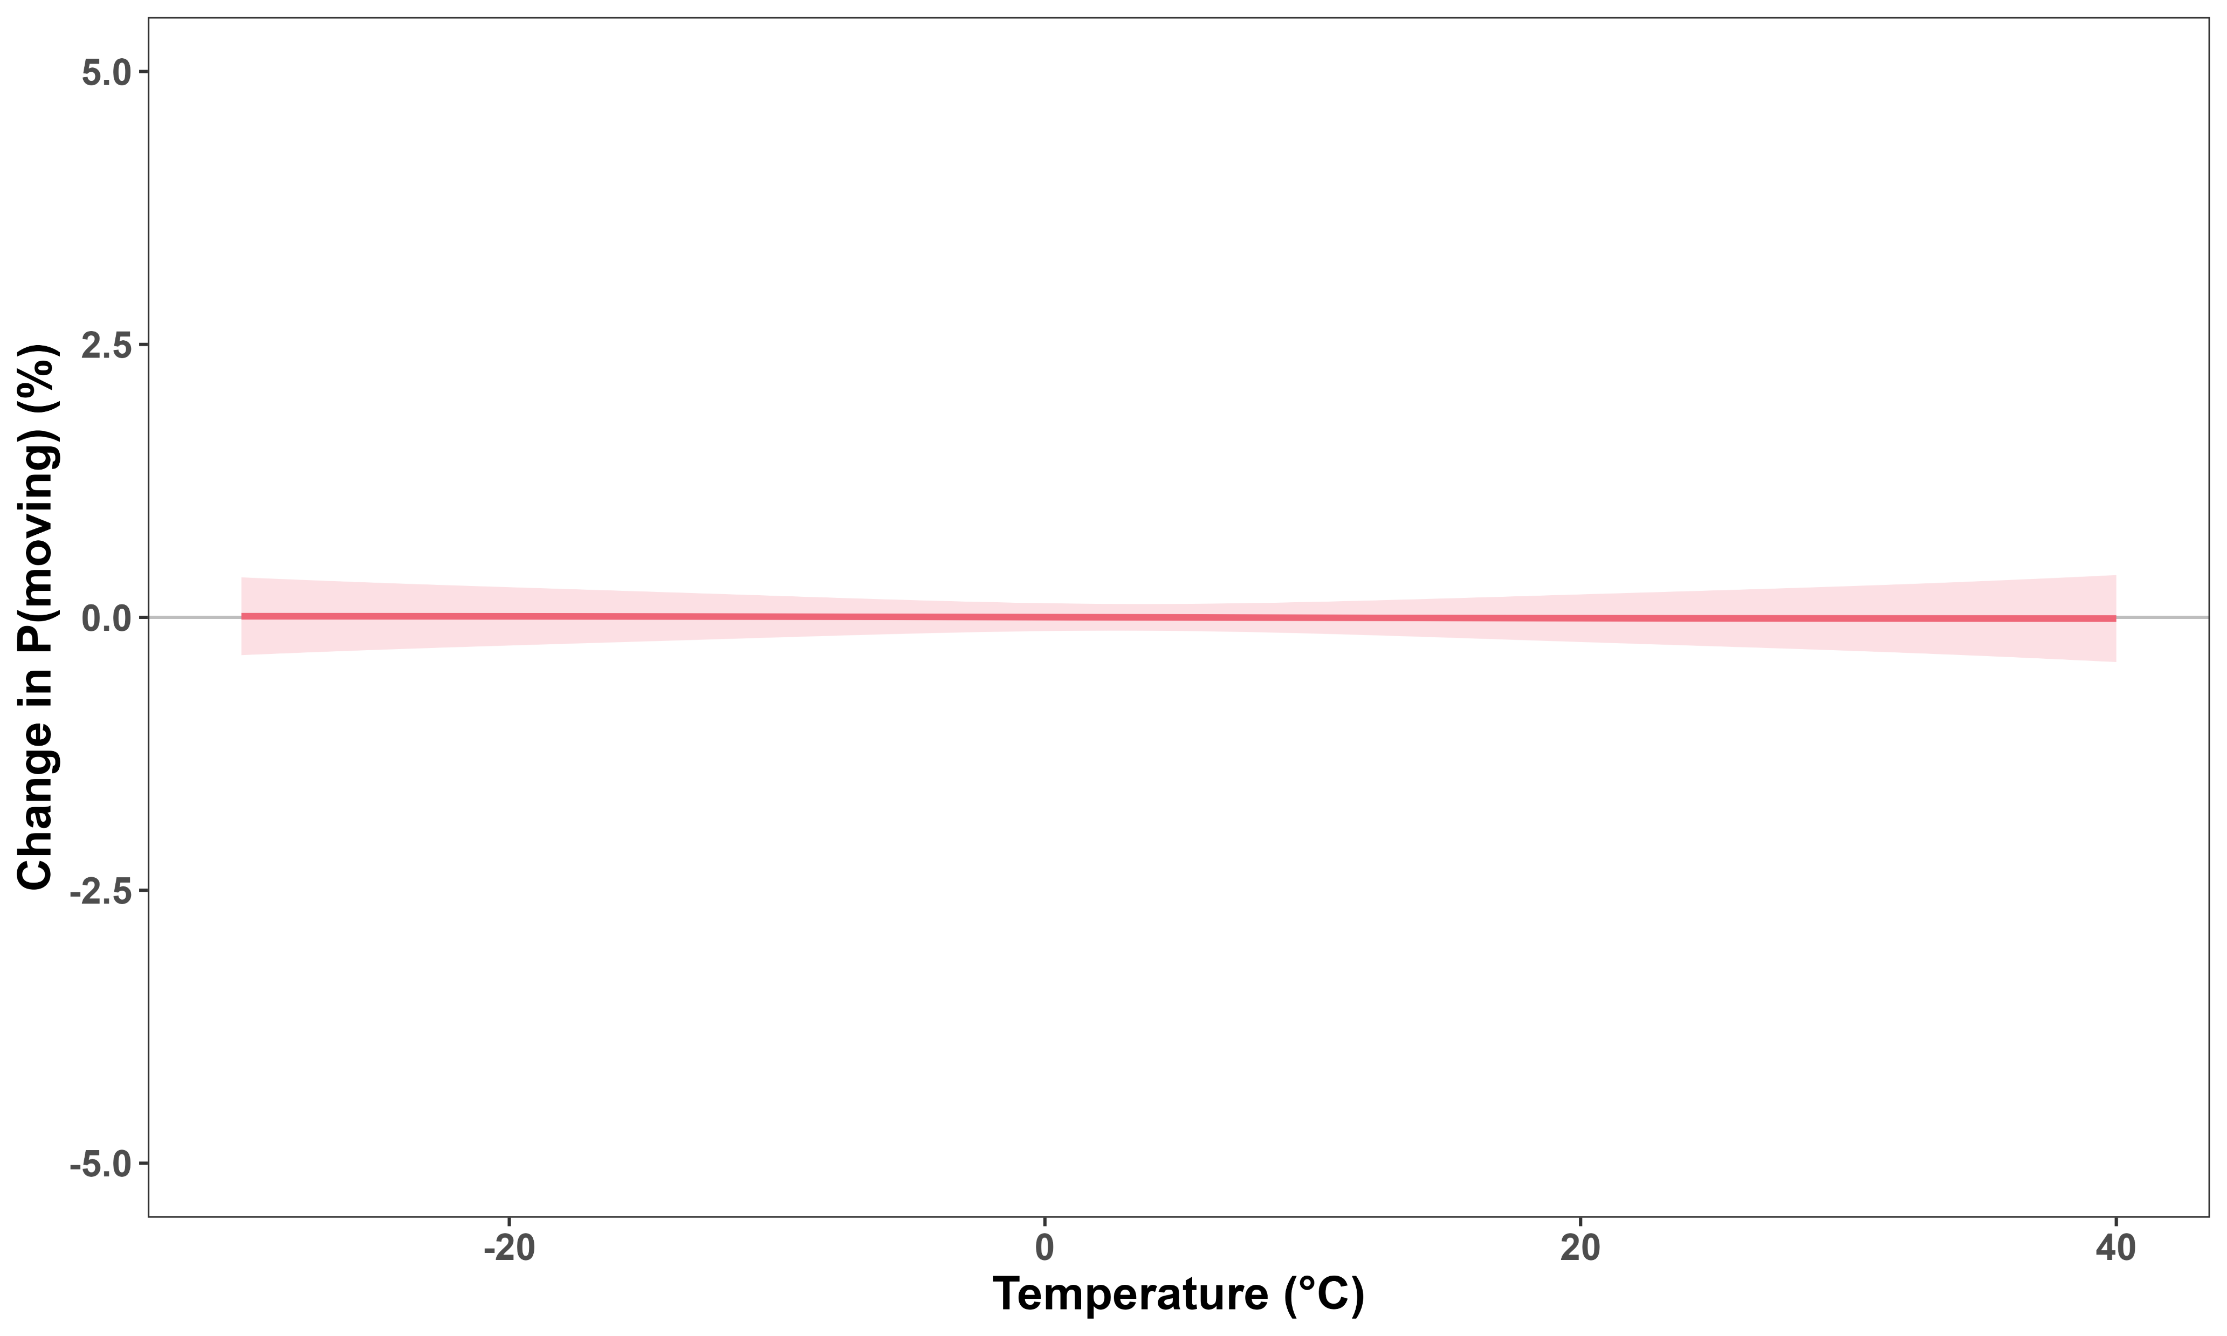
No strong common effect of temperature throughout the year

Slide 42
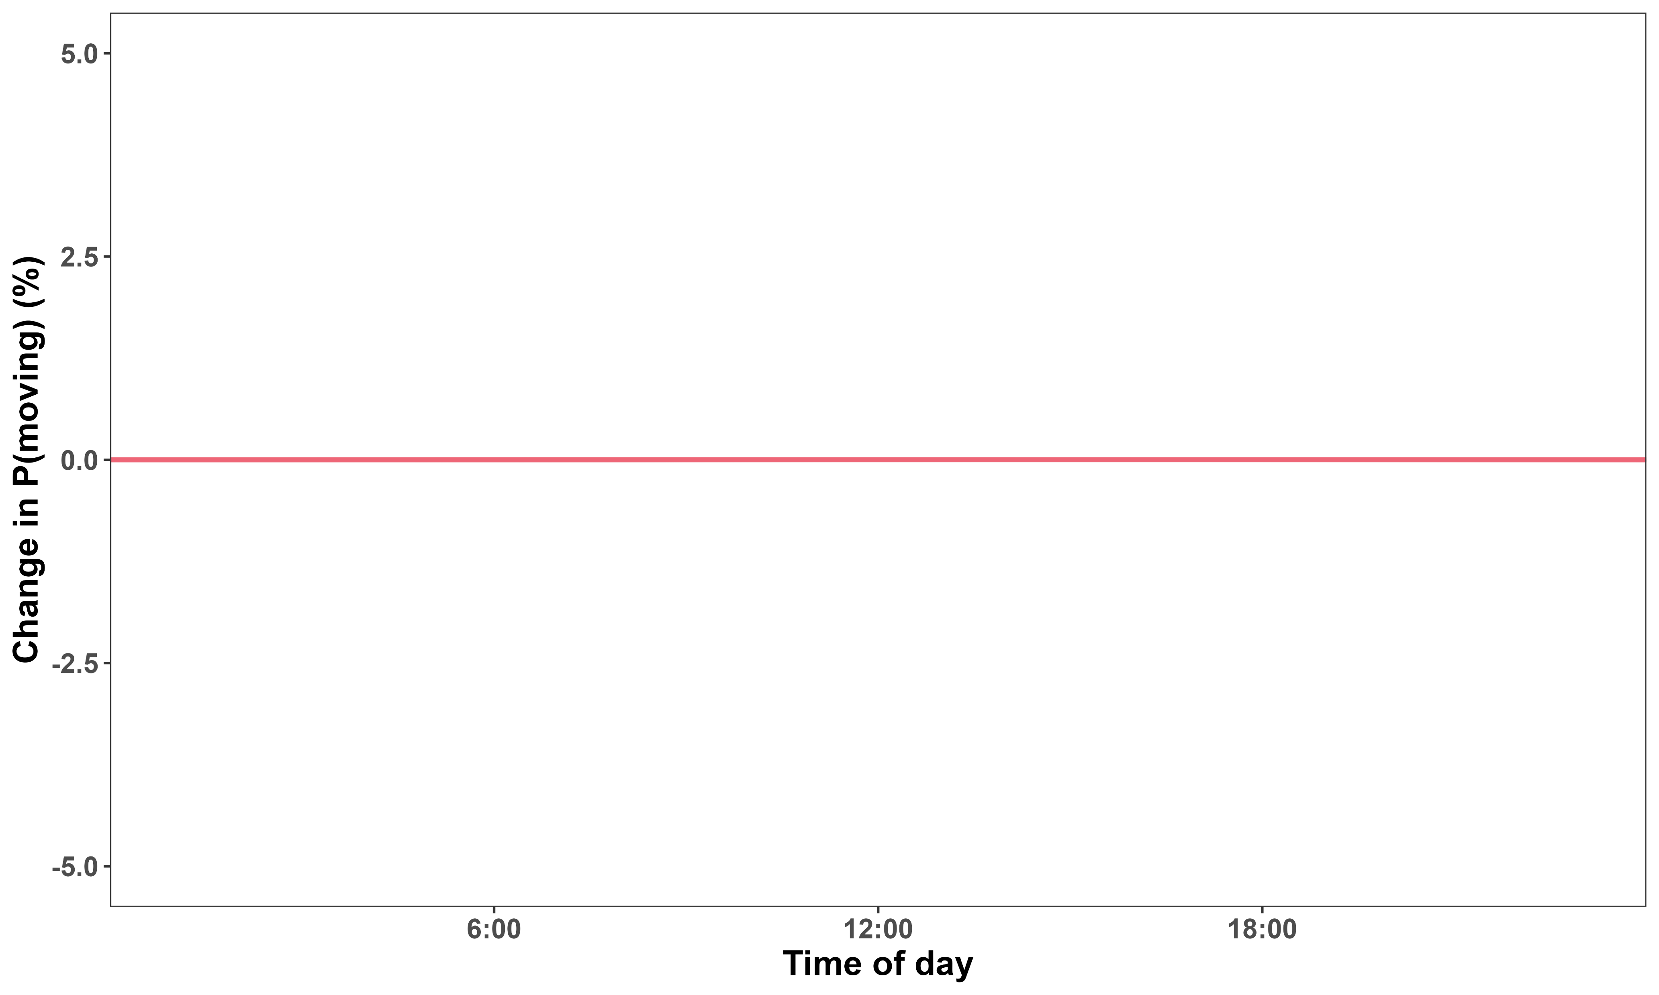
No change detected over time of day

Slide 43
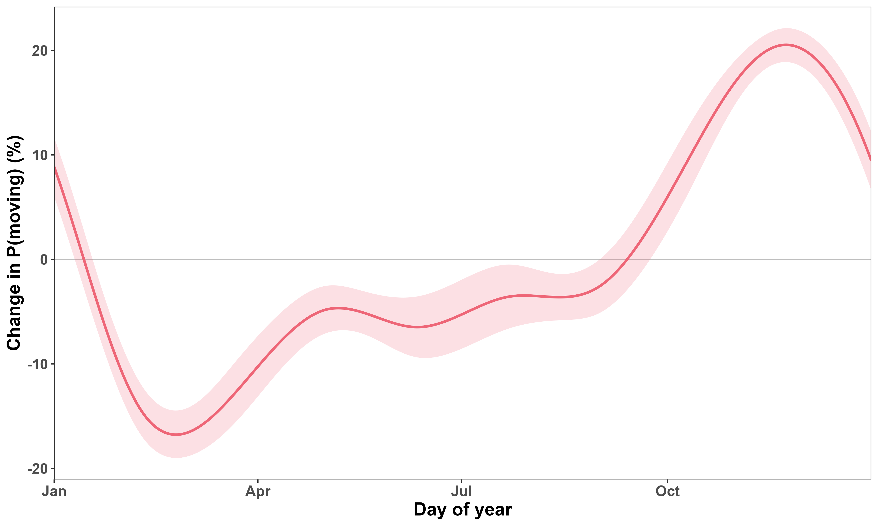
P(moving) varies greatly seasonally

Slide 44
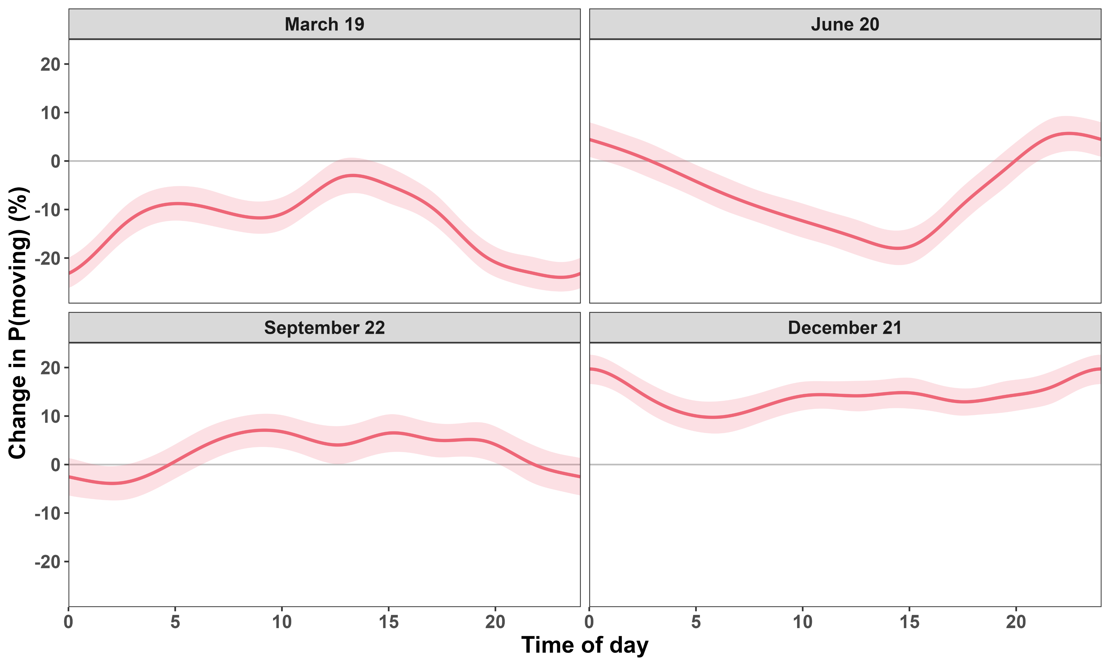
Effects of time of day on P(moving) inverts seasonally

Slide 45
Effect of temperature on P(moving) varies seasonally

Slide 46
Smooth effects of model 2 (movement speed)

Slide 47
Caribou move quite slower at warmer temperatures

Slide 48
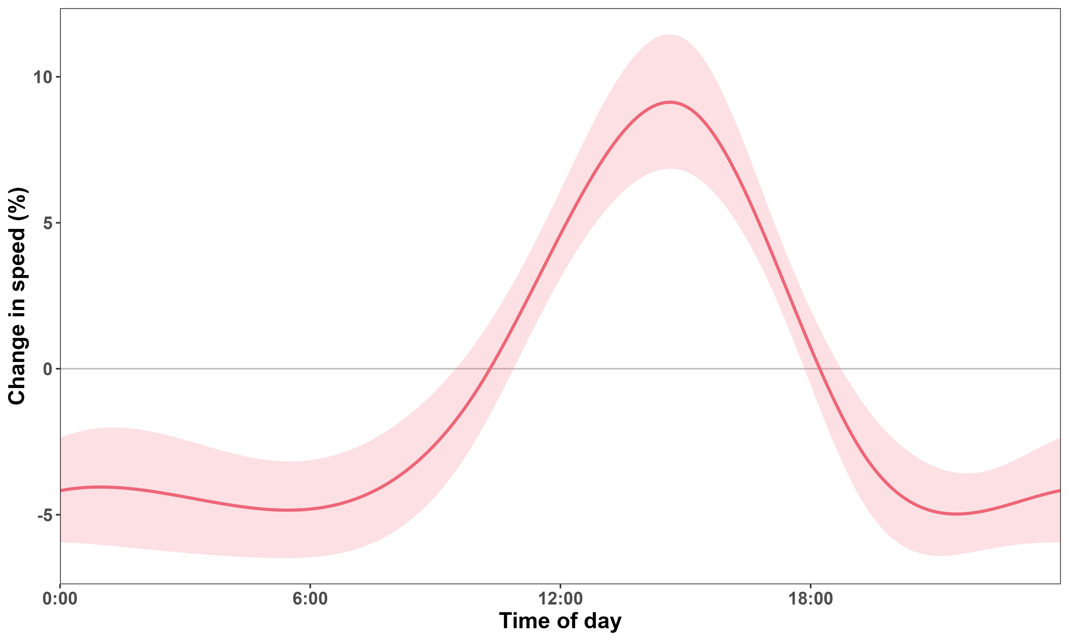
Speed varies over time of day

Slide 49
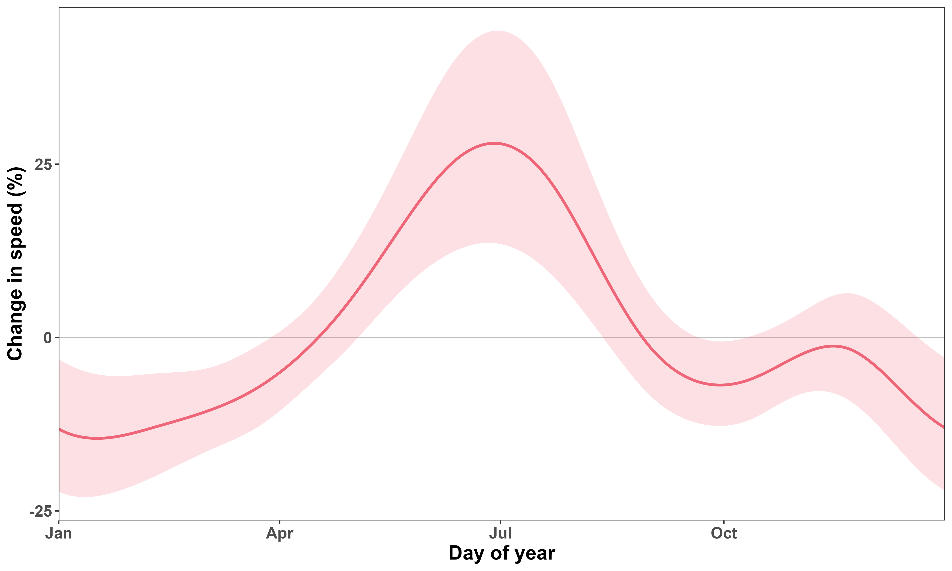
Speed varies greatly seasonally

Slide 50
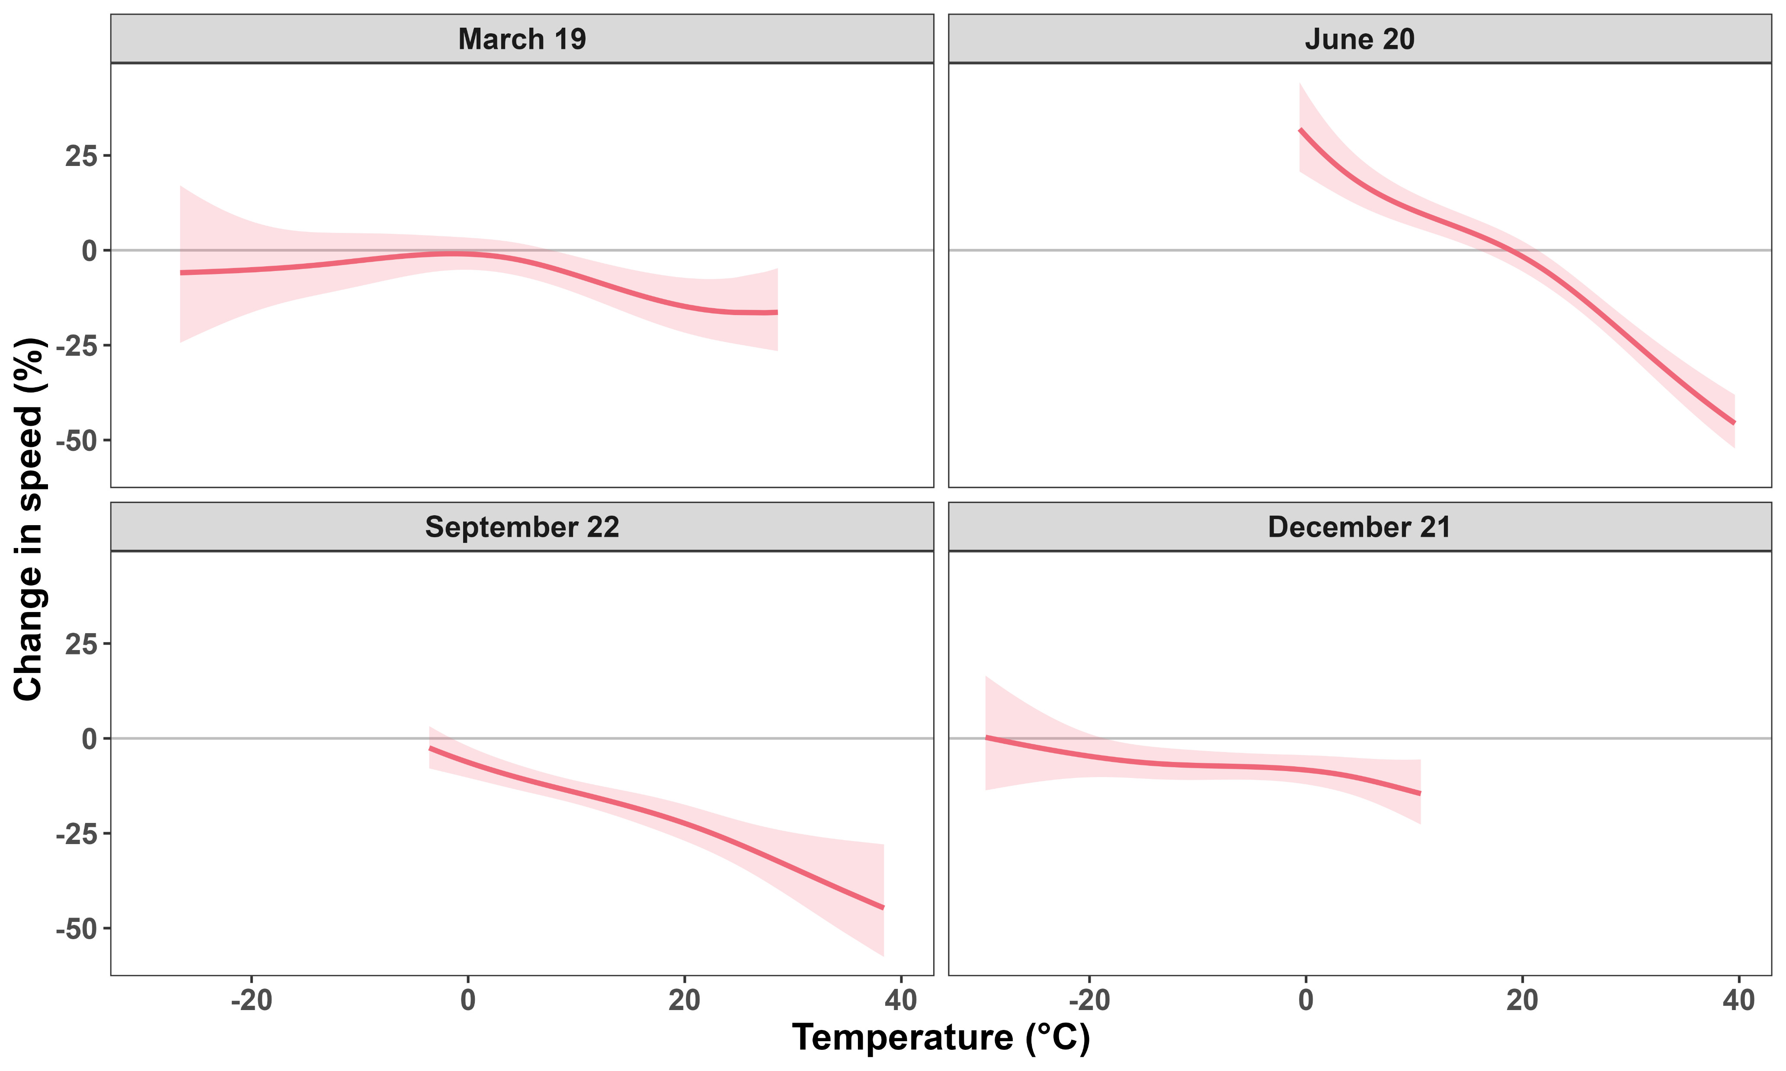
Effect of temperature on speed varies seasonally

Slide 51
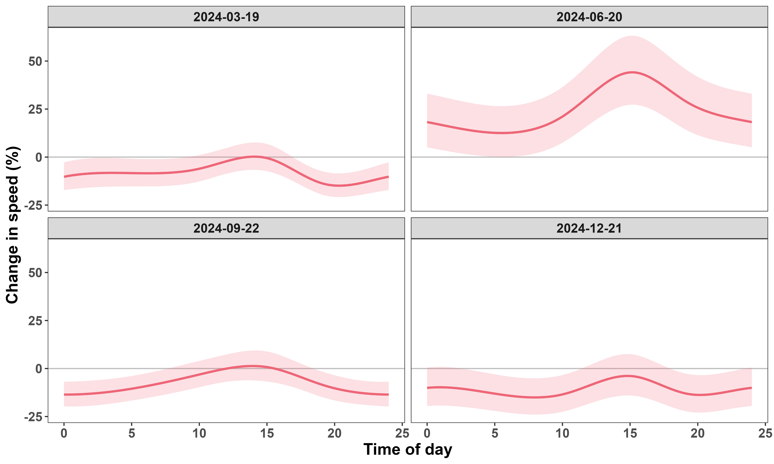
Effect of time of day on speed varies seasonally

